Slide 2
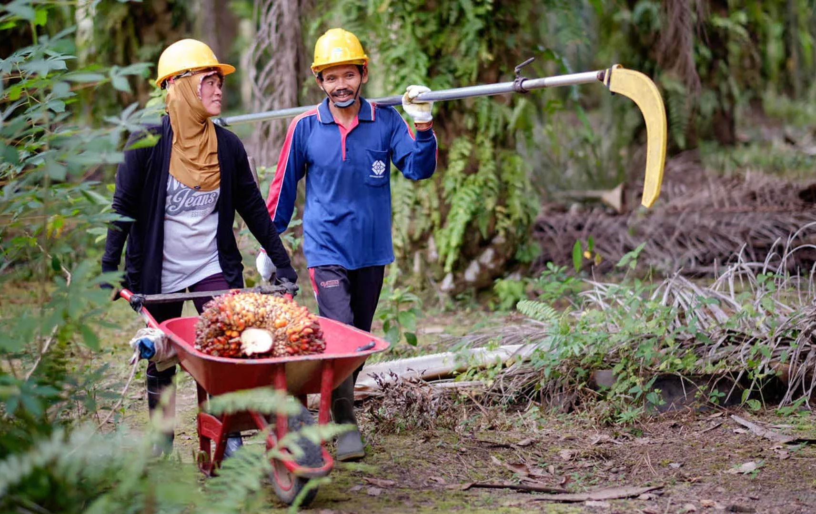
Smallholders
1km
2 P5 UM+C
Douwe Douma
ESA Copernicus II above Eastern Kalimantan palm oil expansion (2019)
© Unilever

Slide 3
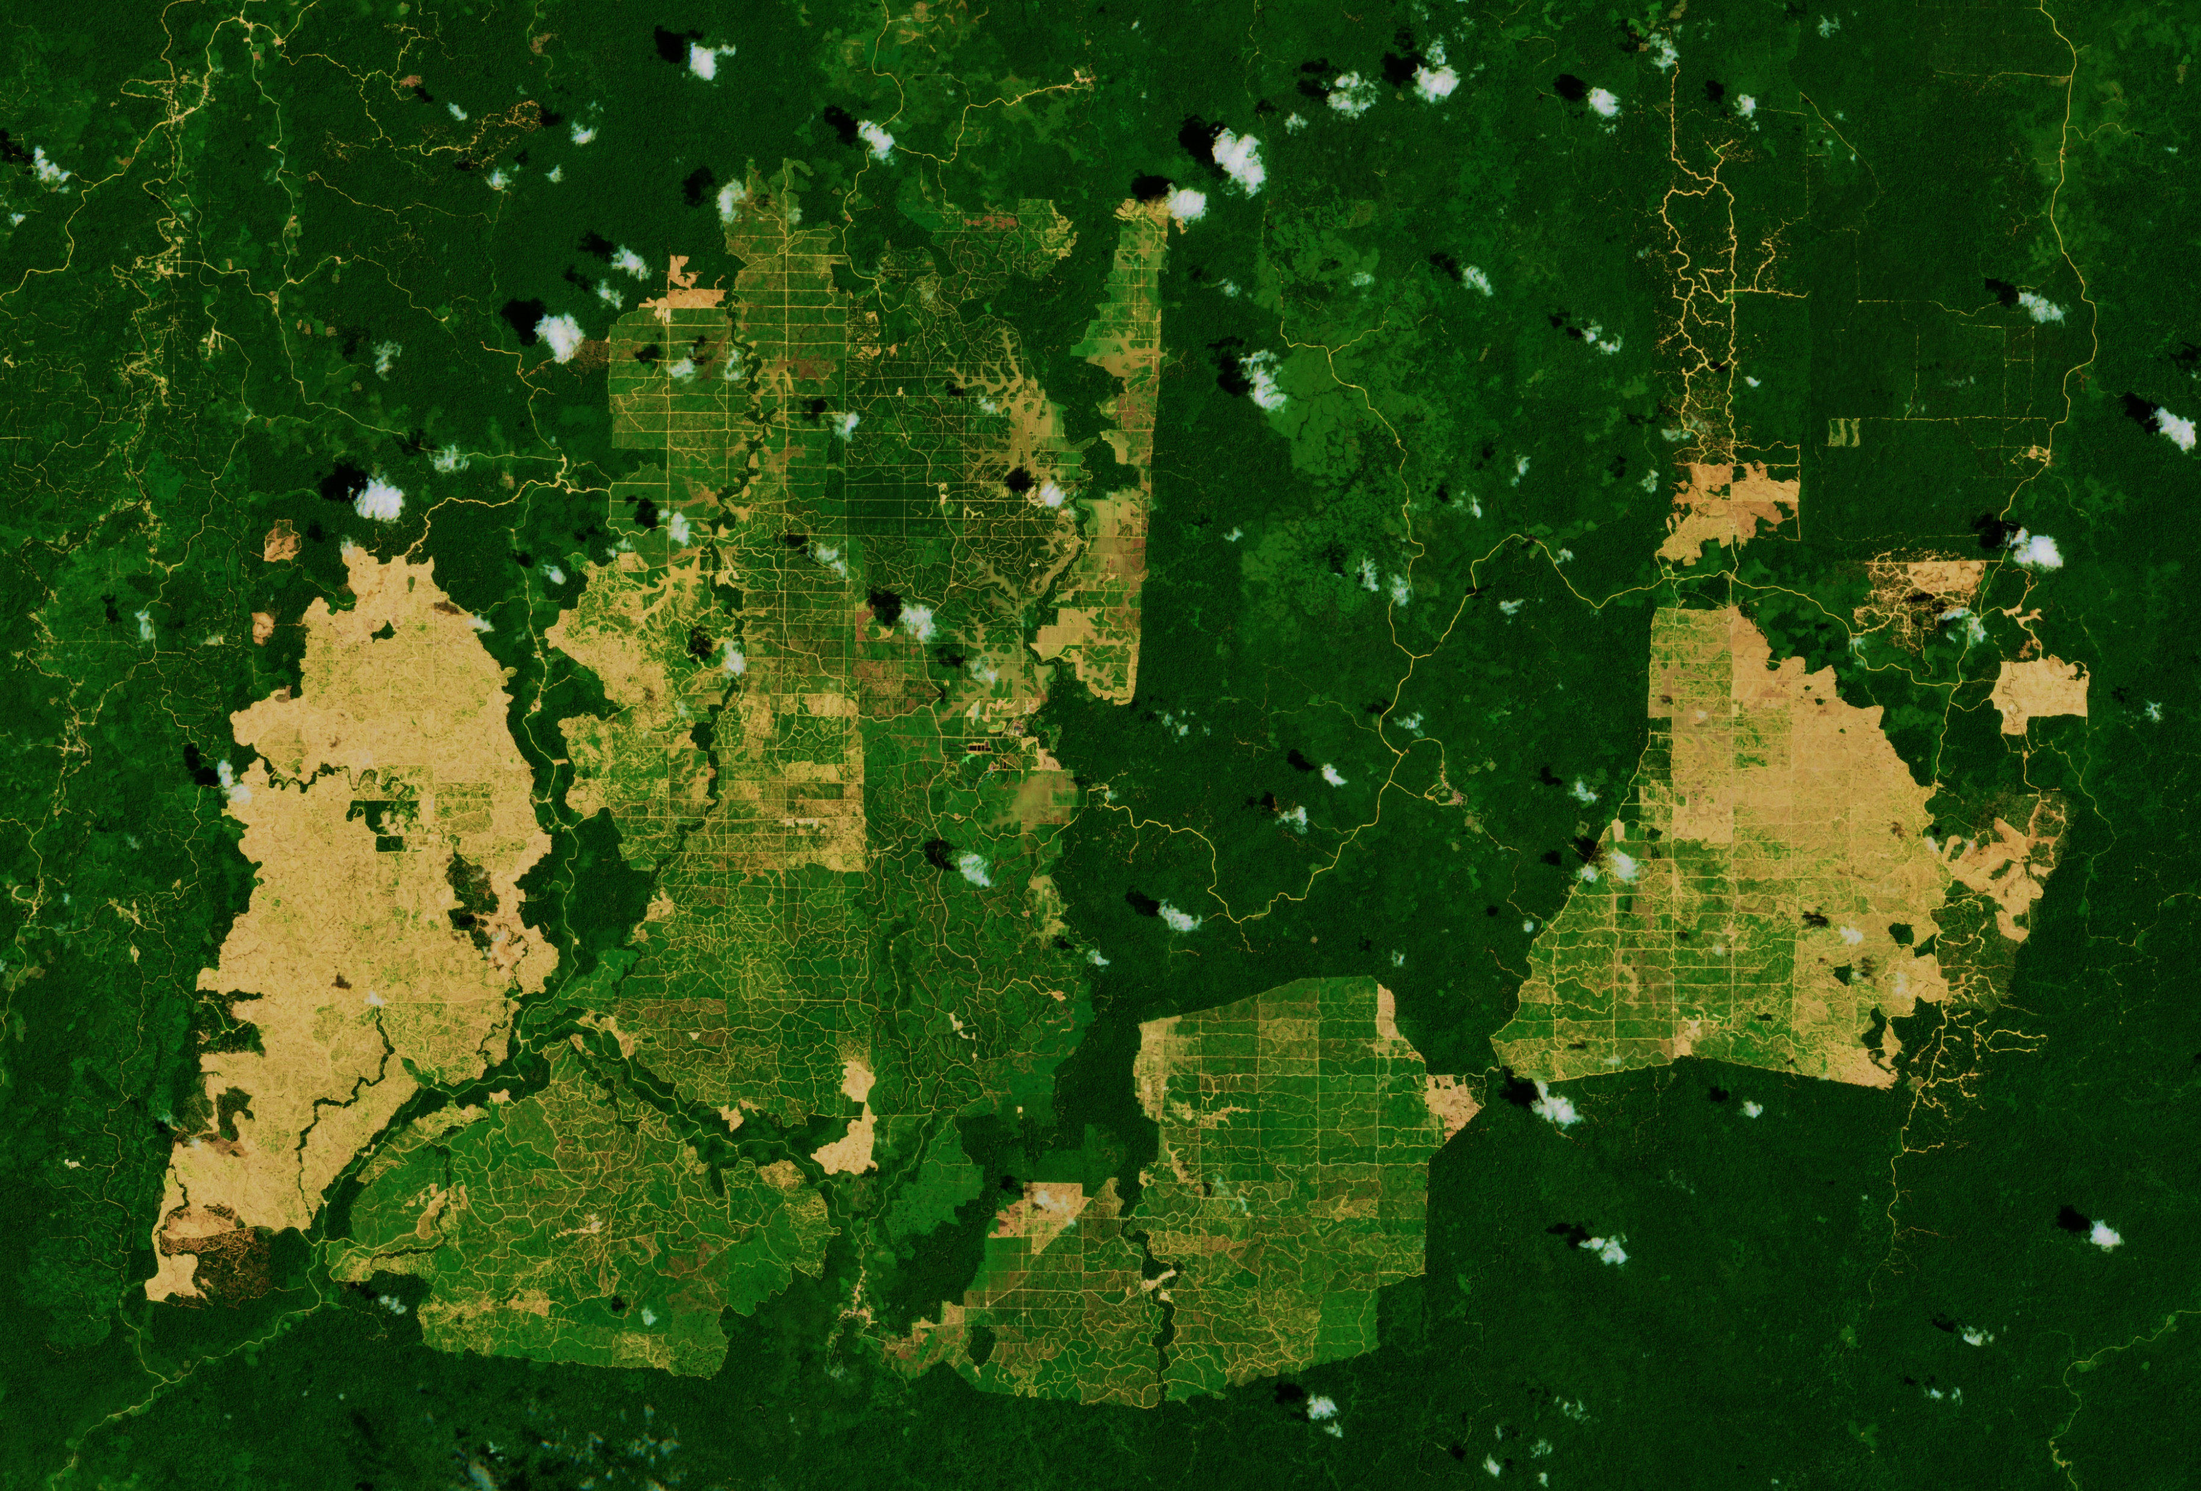
Industrial scale
Gaveau (2021)
1km
3 P5 UM+C
Douwe Douma
ESA Copernicus II above Eastern Kalimantan palm oil expansion (2019)

Slide 4
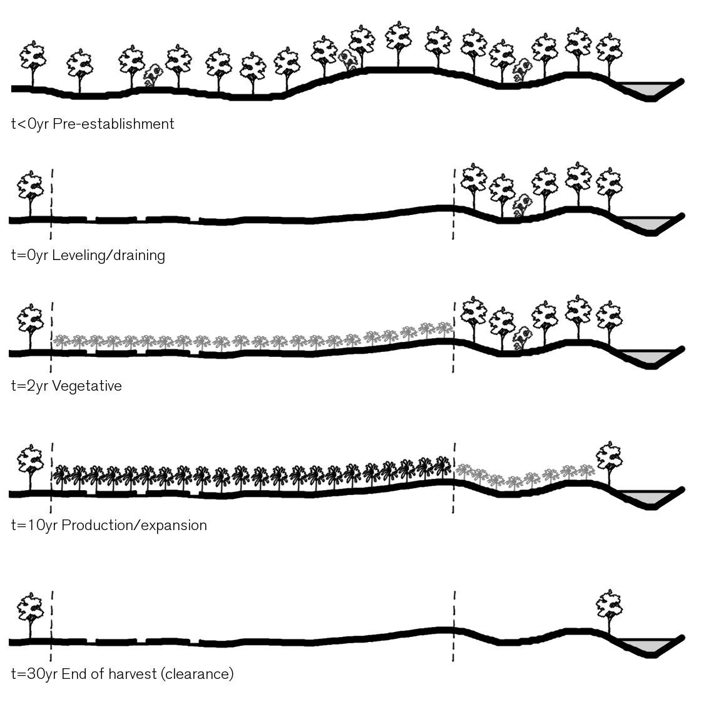
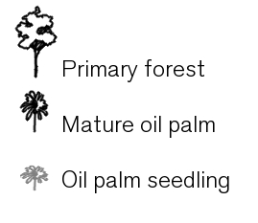
Establishment
1km
4 P5 UM+C
Douwe Douma
ESA Copernicus II above Eastern Kalimantan palm oil expansion (2019)
© Unilever

Slide 5
(economic) Benefits
5 P5 UM+C
Douwe Douma
- Most profitable oil crop (Sung, 2016)
- 58% of global production (USDA Foreign Agricultural Service, 2021)
- 7.5 million employees (Sung, 2016)
- 85% for export, worth 20 billion USD (Shigetomi, Ishimura, & Yamamoto, 2020)
- Infrastructure
Notes:
Abood concludes that indirectly, palm oil accounts to deforestation through several other pathways: (1) replacement of forests that were previously degraded by logging or fire; (2) joint economic ventures that first clear land for timber and then install palm plantations; (3) increasing access to remote forests through road infrastructure; and (4) displacement of food crops into forests (Fitzherbert, 2008). Fitzherbert (2008) concludes that over 50% of Indonesian deforestation during 1990-2005 was directly and indirectly caused by the expansion of oil palm plantations in Sumatra and Kalimantan.

Slide 6
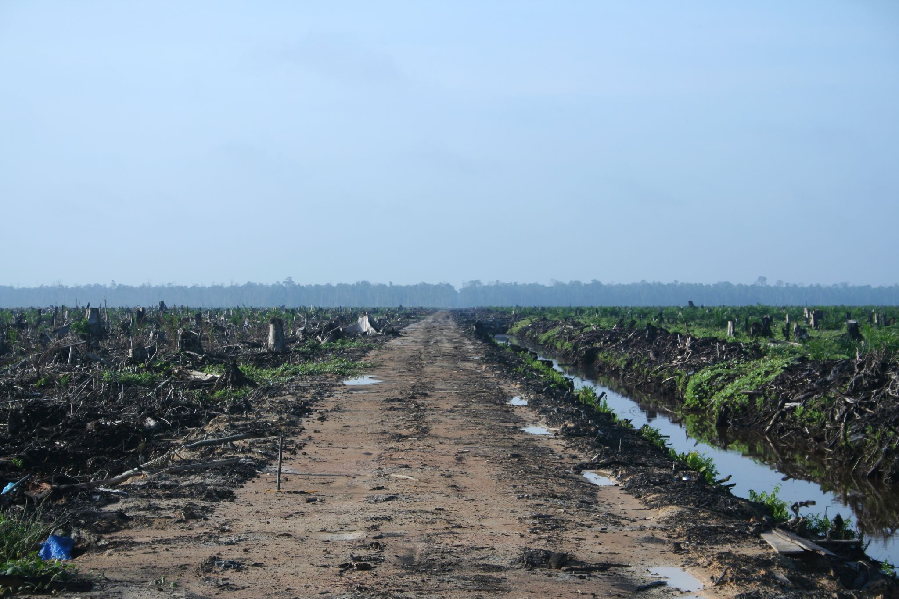
Problem statement
6 P5 UM+C
Douwe Douma
Main driver (~50%) of deforestation.
- Devastates local environment (soil, water & air conditions)
- Biodiversity loss
- Vulnerability to flood and fire
- Carbon emissions
© H Dragon
Notes:
Abood concludes that indirectly, palm oil accounts to deforestation through several other pathways: (1) replacement of forests that were previously degraded by logging or fire; (2) joint economic ventures that first clear land for timber and then install palm plantations; (3) increasing access to remote forests through road infrastructure; and (4) displacement of food crops into forests (Fitzherbert, 2008). Fitzherbert (2008) concludes that over 50% of Indonesian deforestation during 1990-2005 was directly and indirectly caused by the expansion of oil palm plantations in Sumatra and Kalimantan.

Slide 7
Research Goal
7 P5 UM+C
Douwe Douma
‘Regenerative’ spatial guidelines
for oil palm plantations in Kalimantan
lower environmental impact
(2) while stabilizing biodiversity
(3) within a changing climate.

Slide 8
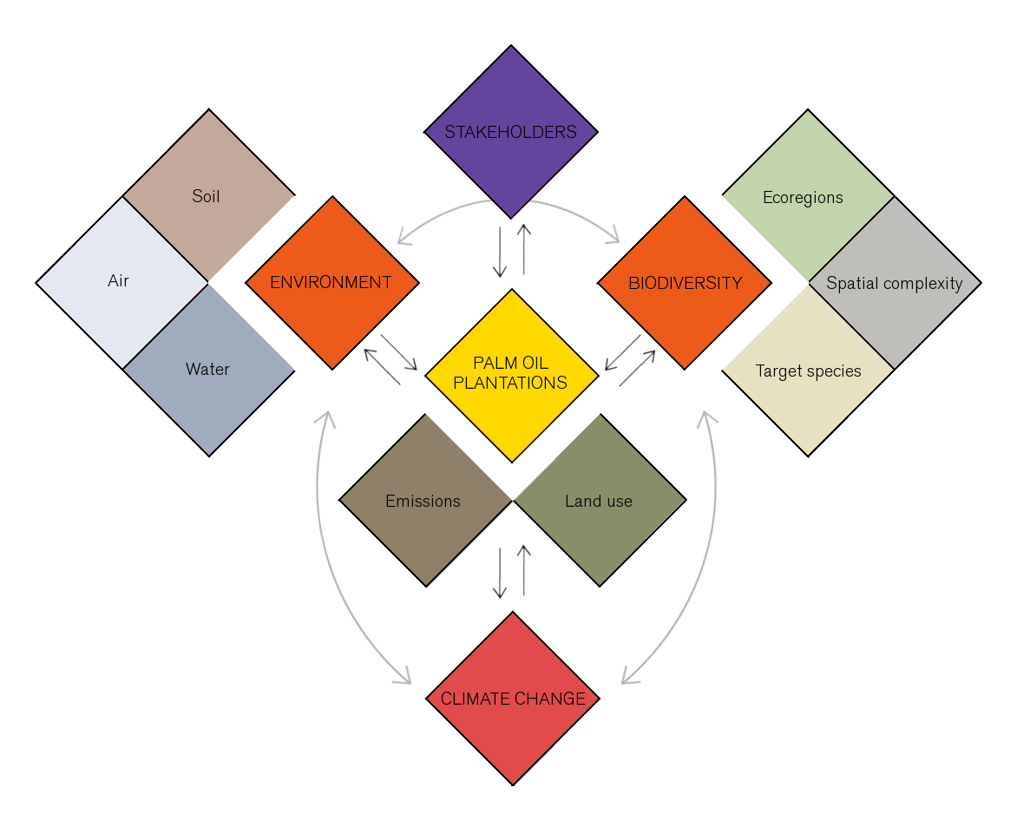
Conceptual FW
8 P5 UM+C
Douwe Douma

Slide 9
9 P5 UM+C
Douwe Douma
Analysis

Slide 10
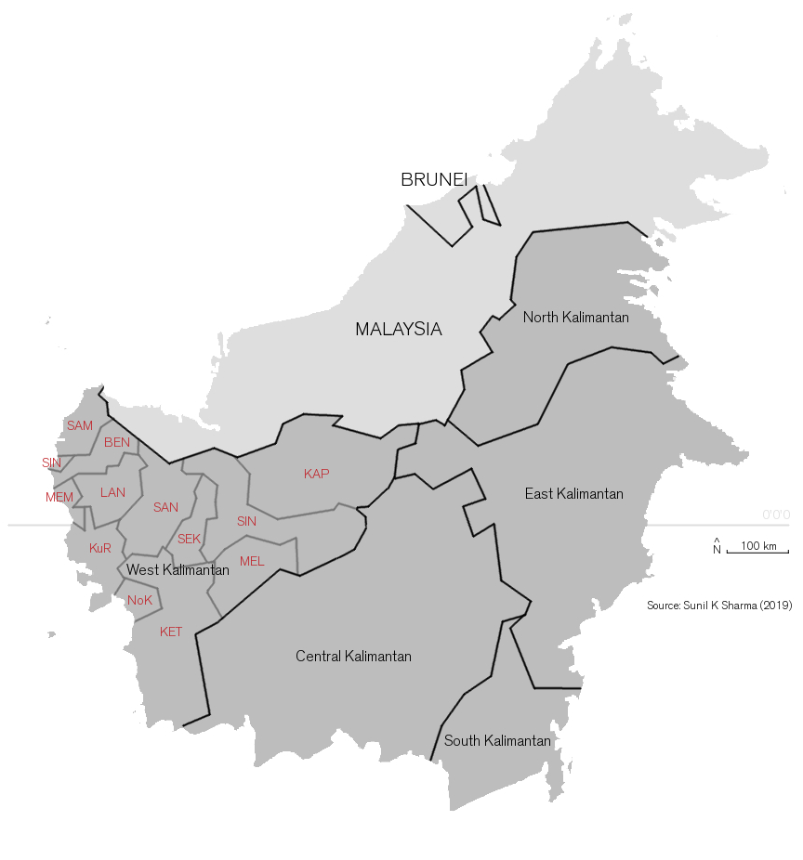
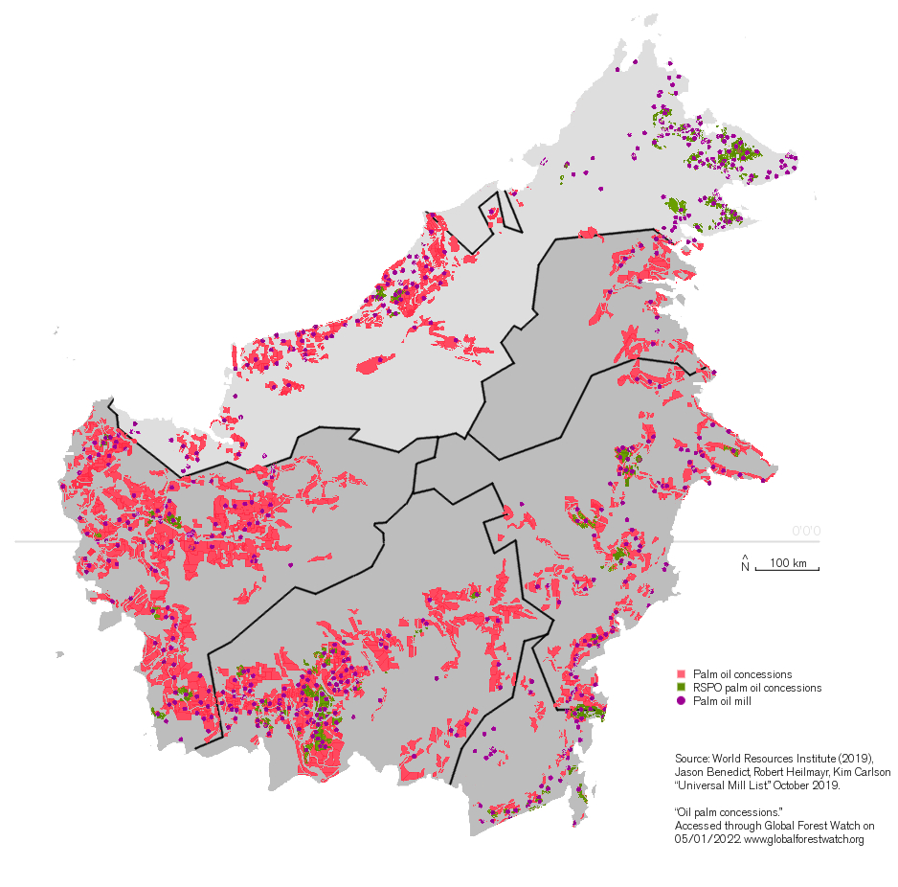
10 P5 UM+C
Douwe Douma
Kalimantan
Palm oil concessions
2019

Slide 11
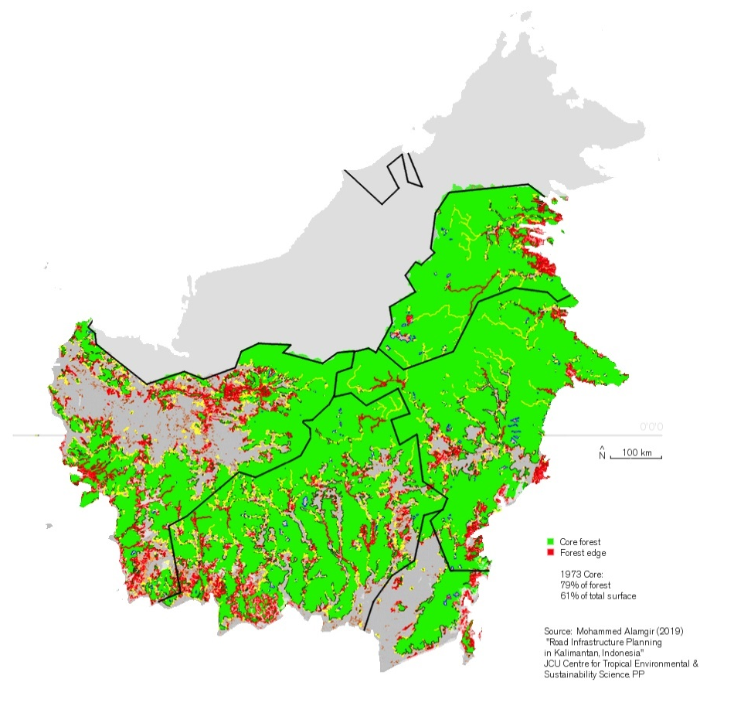
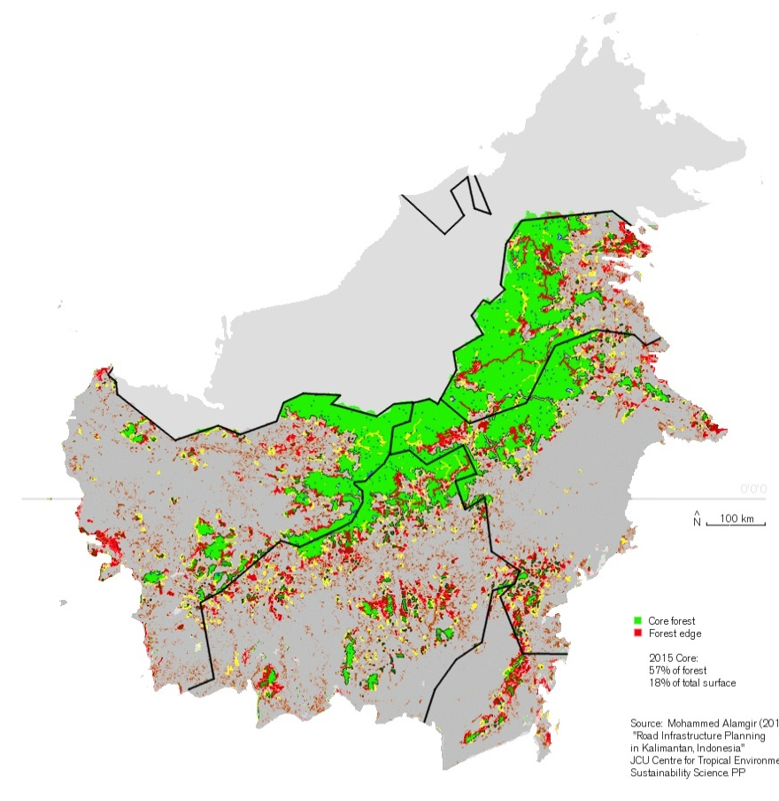
11 P5 UM+C
Douwe Douma
Deforestation
1973
2015
Notes:
While economically attractive, the expansion of palm oil plantations in Indonesia is controversial. Fitzherbert (2008) concluded that over 50% of Indonesian deforestation during 1990-2005 was directly and indirectly caused by the expansion of oil palm plantations in Sumatra and Kalimantan.
On Kalimantan in particular, 61% of the islands surface was covered with primary forest in 1970. This number went down to 18% just 45 years later (Mohammed Alamgir, 2019). In addition to the core forest surface loss, the forest became fragmented (patchwork) which is detrimental for native biodiversity.

Slide 12
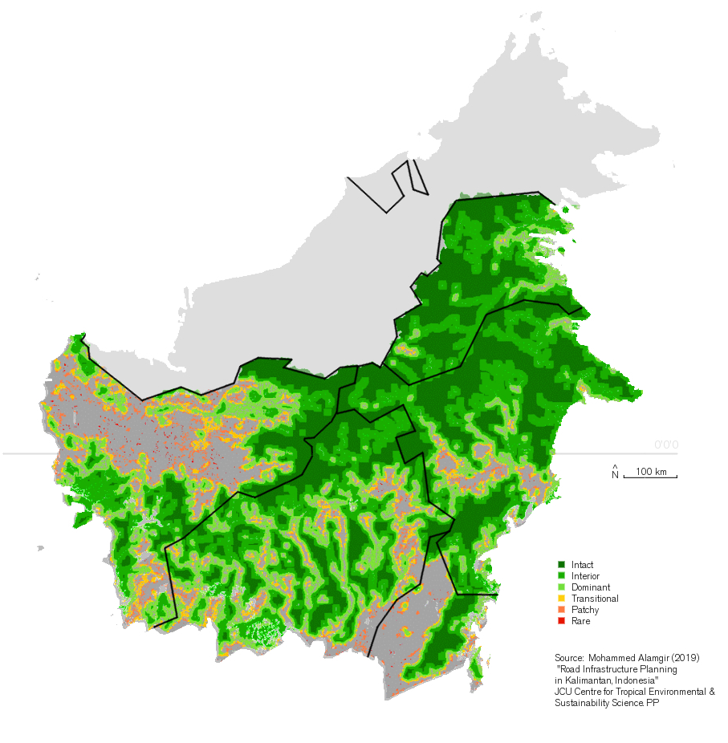
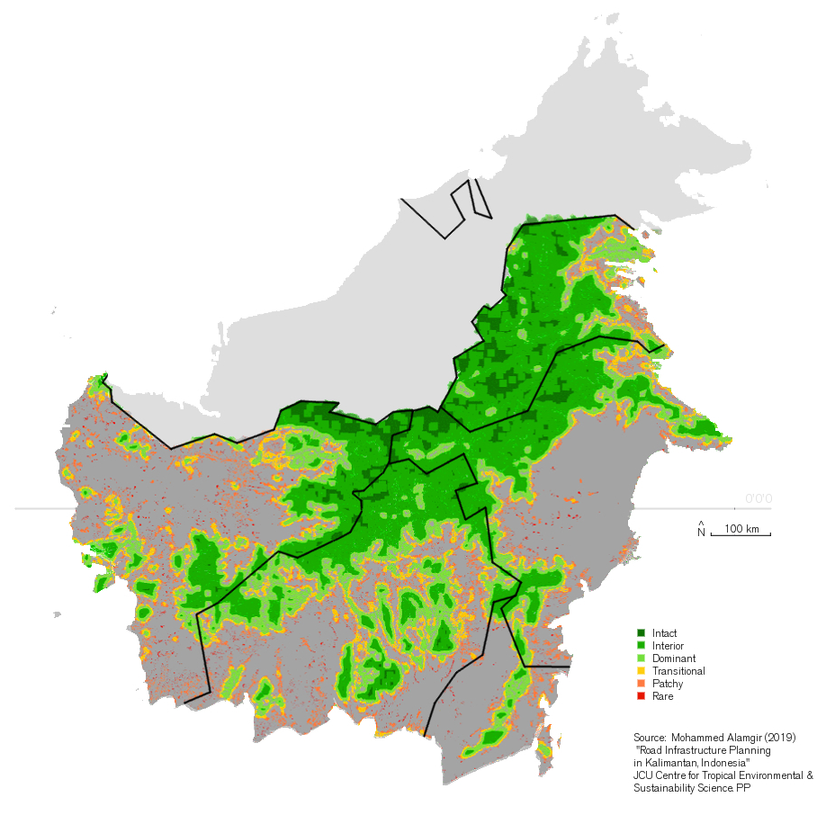
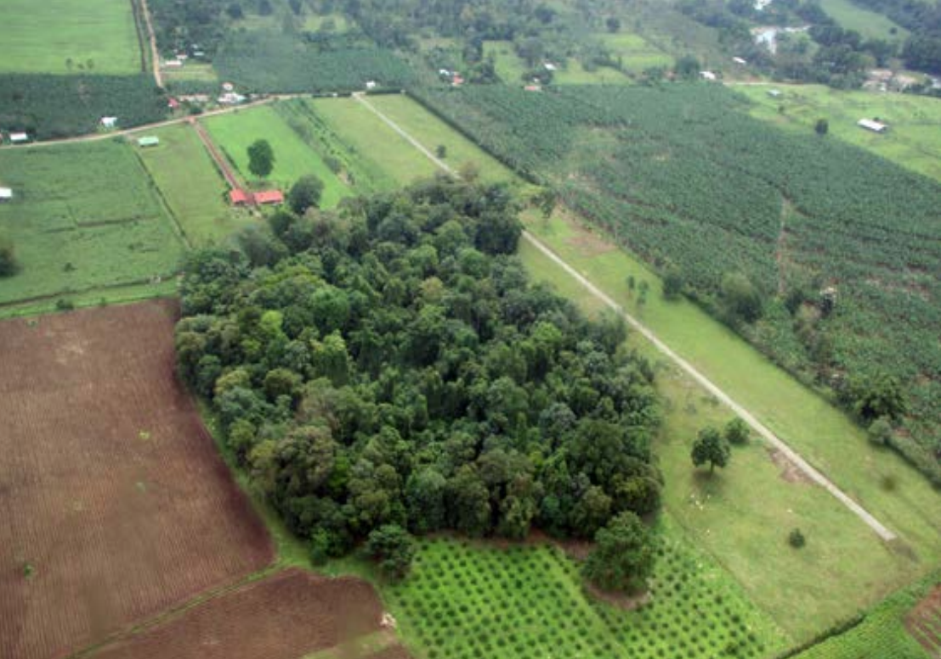
12 P5 UM+C
Douwe Douma
Fragmentation
1973
2015
Notes:
While economically attractive, the expansion of palm oil plantations in Indonesia is controversial. Fitzherbert (2008) concluded that over 50% of Indonesian deforestation during 1990-2005 was directly and indirectly caused by the expansion of oil palm plantations in Sumatra and Kalimantan.
On Kalimantan in particular, 61% of the islands surface was covered with primary forest in 1970. This number went down to 18% just 45 years later (Mohammed Alamgir, 2019). In addition to the core forest surface loss, the forest became fragmented (patchwork) which is detrimental for native biodiversity.

Slide 13
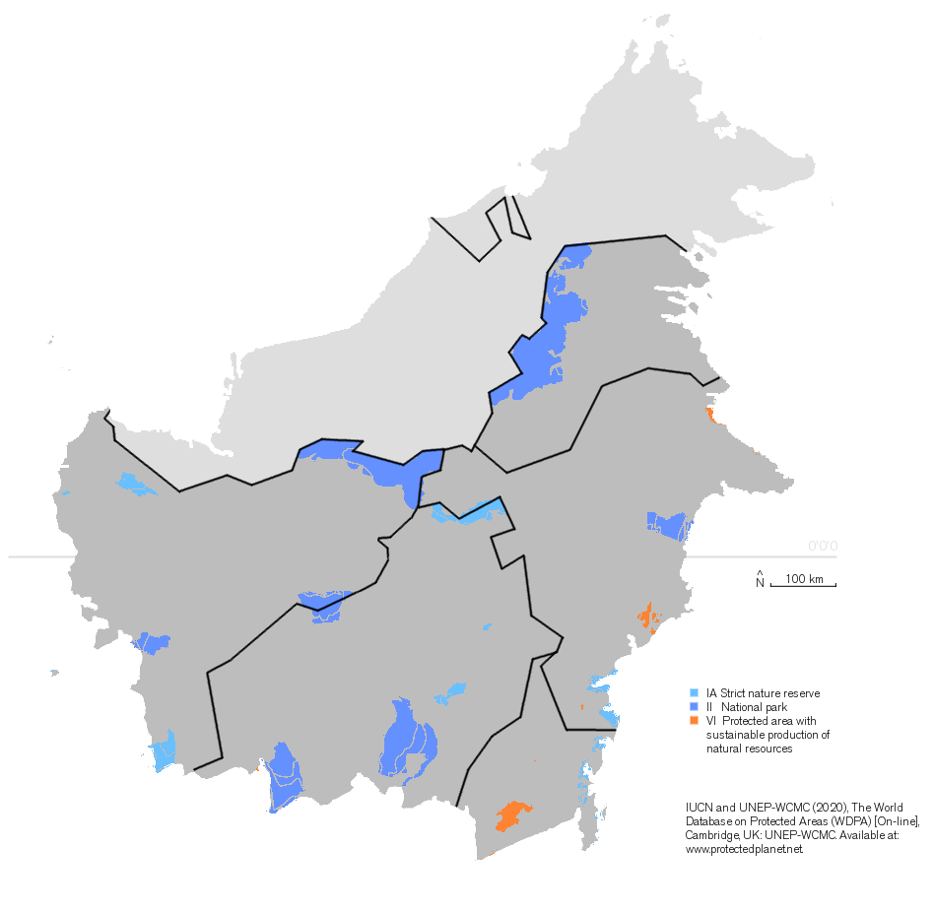
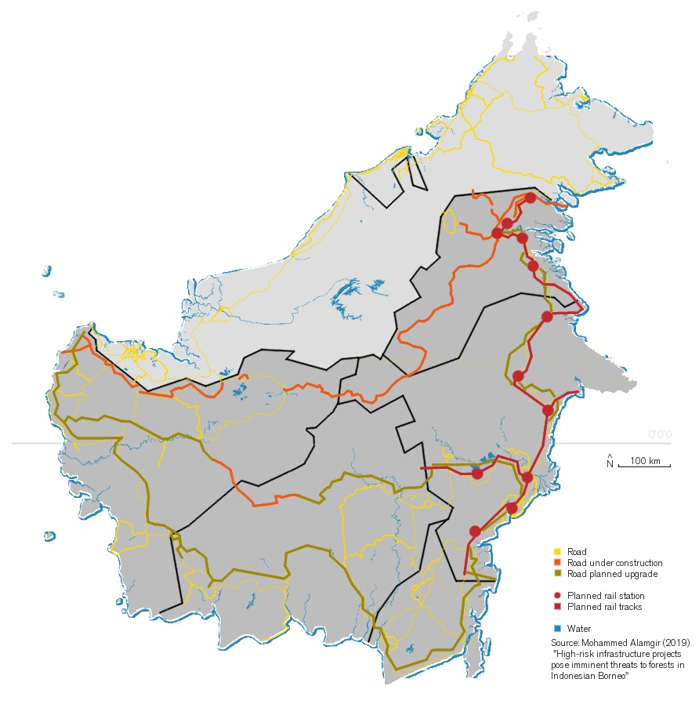
13 P5 UM+C
Douwe Douma
Conservation
Infrastructure
2020
2019

Slide 14
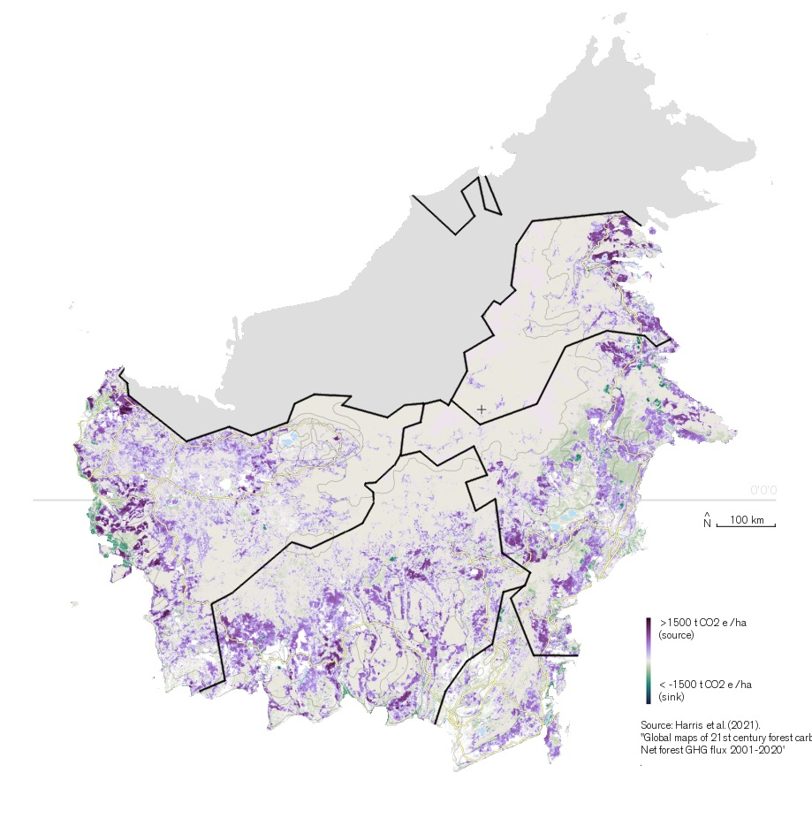
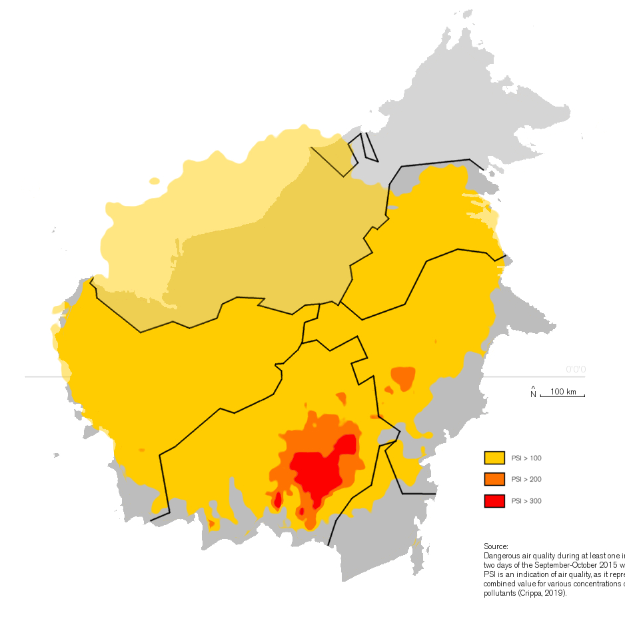
14 P5 UM+C
Douwe Douma
GHG
Wildfire haze
2021
2019

Slide 15
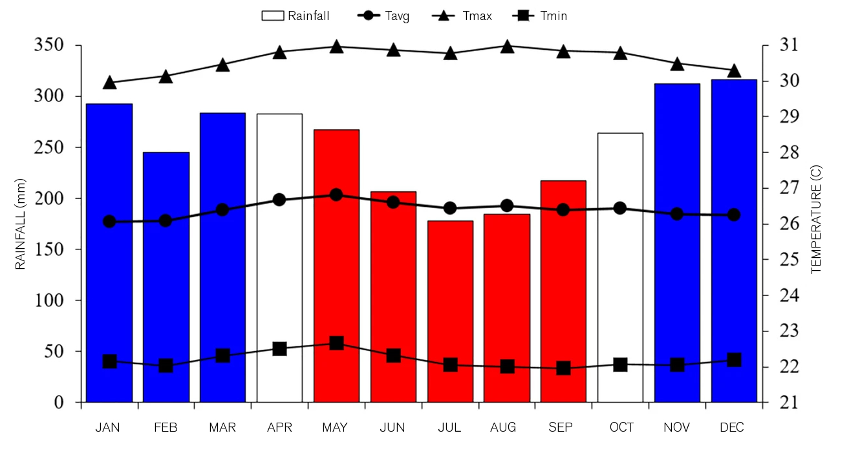
15 P5 UM+C
Douwe Douma

Slide 16
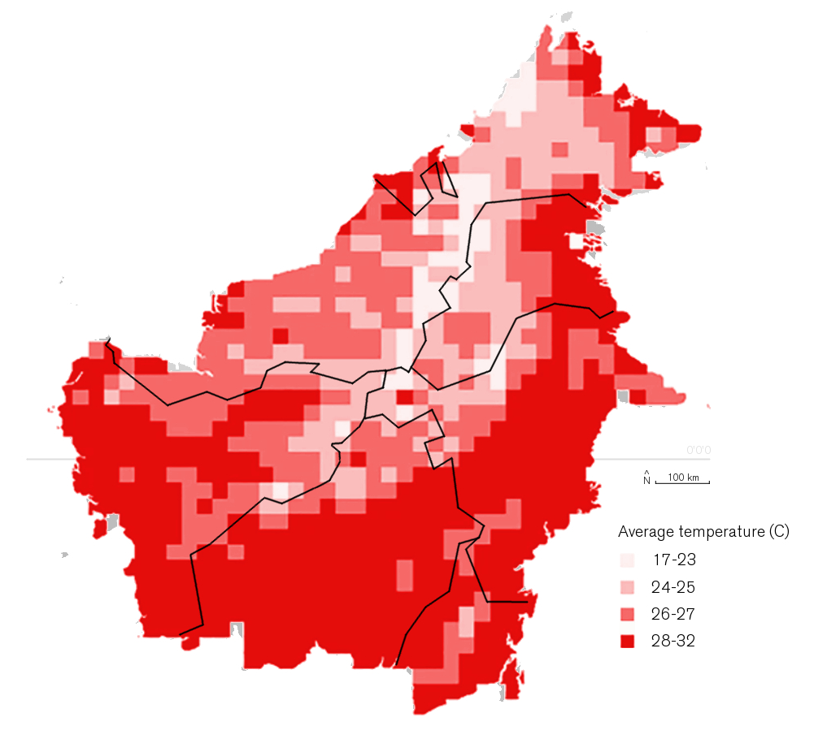
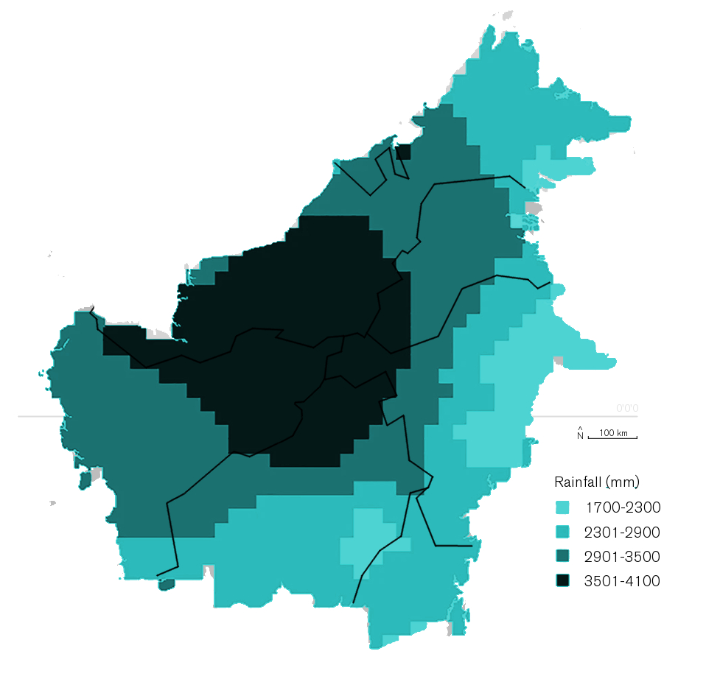
16 P5 UM+C
Douwe Douma
Mean maximum temperature
Monthly precipitation
2021
2021

Slide 17
Literature review conclusions
17 P5 UM+C
Douwe Douma
Soil
- Soil erosion
- Reduced natural fertility
- Artificial fertilizer overshoot

Slide 18
Literature review conclusions
18 P5 UM+C
Douwe Douma
Air
- Increase in microclimate air temperature
- Carbon emissions
(forest 702±183 MgCO₂ ha⁻¹, peat 3452±1294 MgCO₂ ha⁻¹)

Slide 19
Literature review conclusions
19 P5 UM+C
Douwe Douma
Water
Reduced storage capacity
Lower overall water quality
Oil palm will die in waterlogged conditions

Slide 20
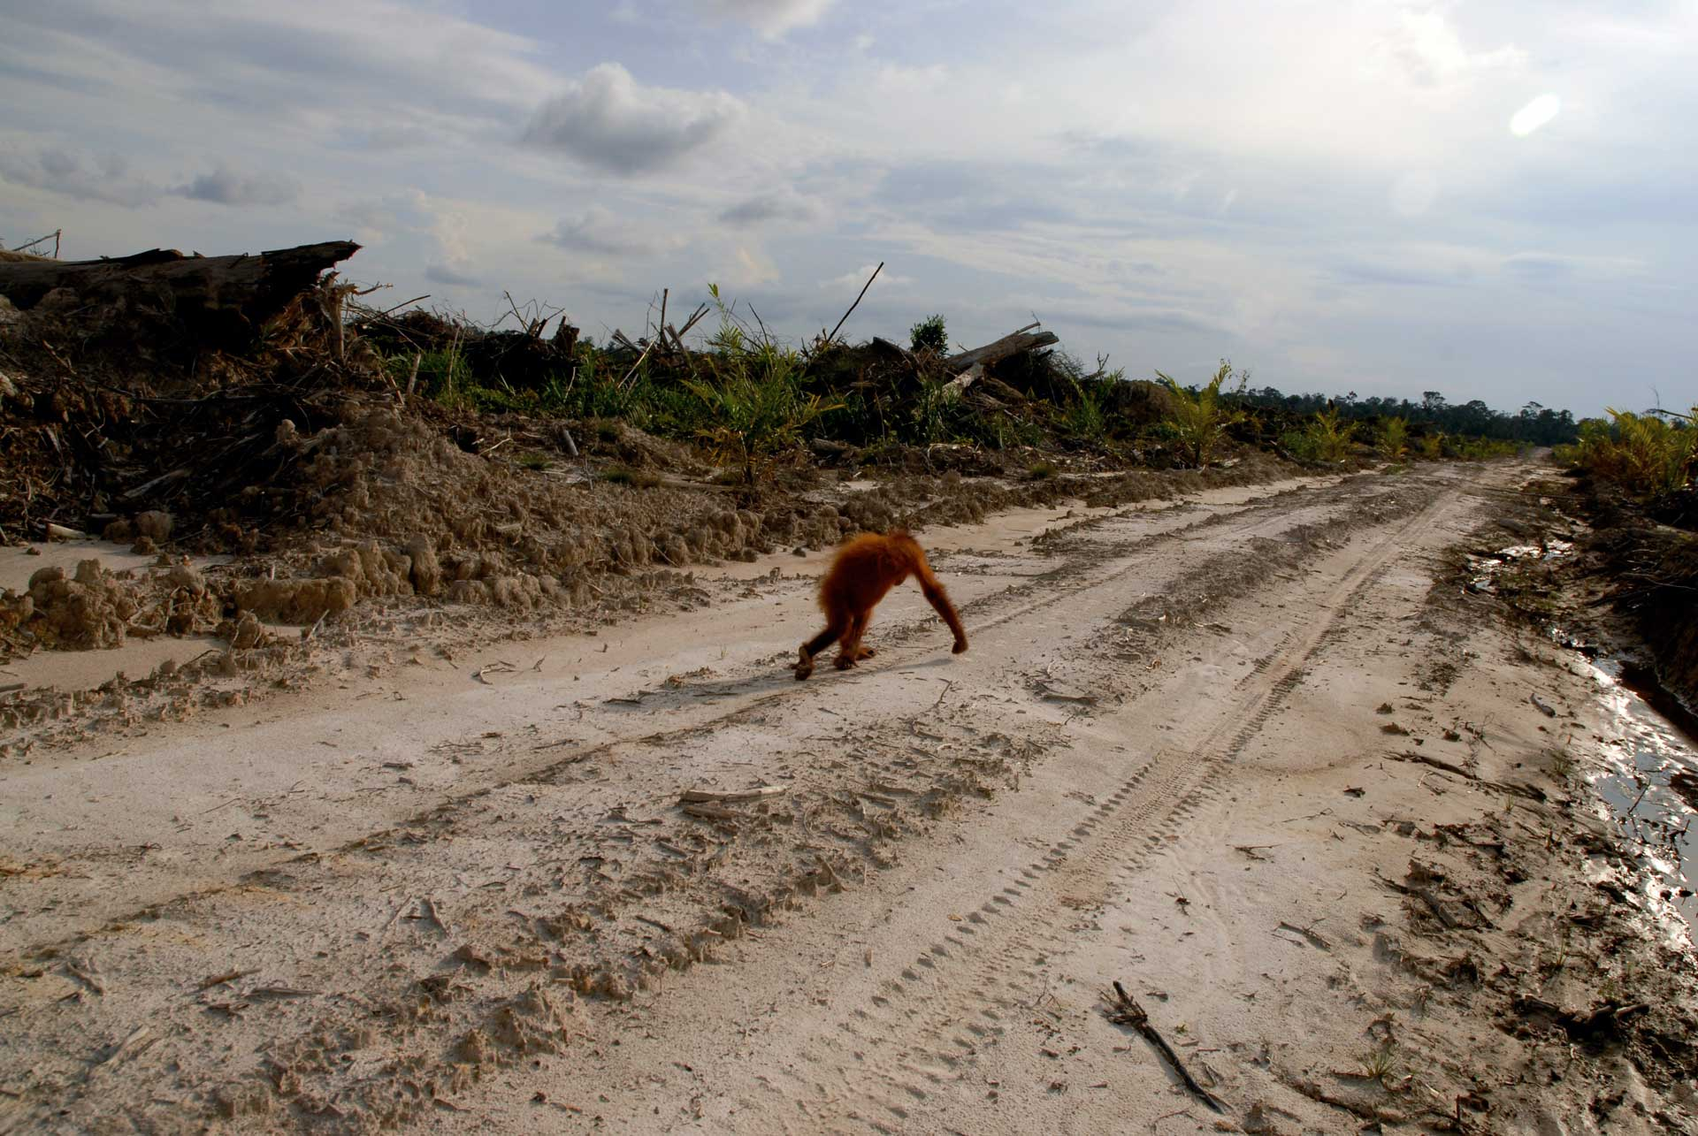
Biodiversity
1km
20 P5 UM+C
Douwe Douma
ESA Copernicus II above Eastern Kalimantan palm oil expansion (2019)
© Unilever

Slide 21
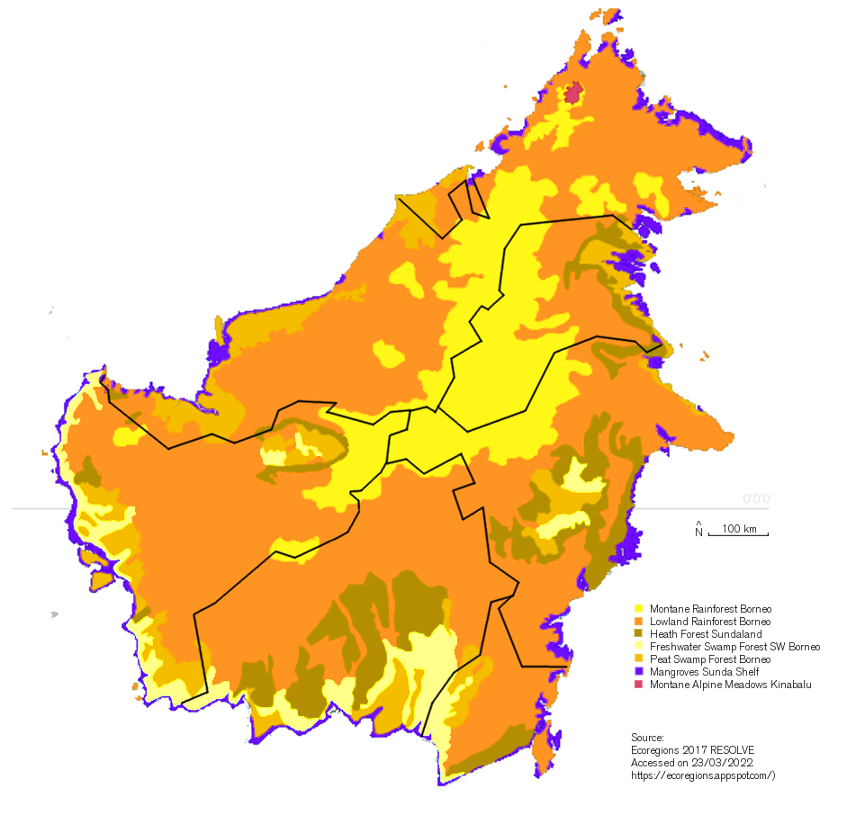
Ecoregions
21 P5 UM+C
Douwe Douma

Slide 22
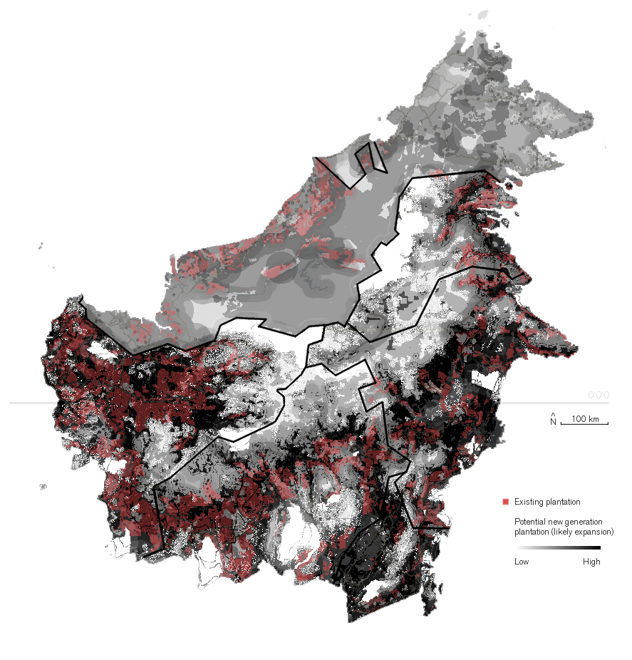
Oil palm threat
22 P5 UM+C
Douwe Douma
Palm oil concessions
Expected expansion
2019

Slide 23
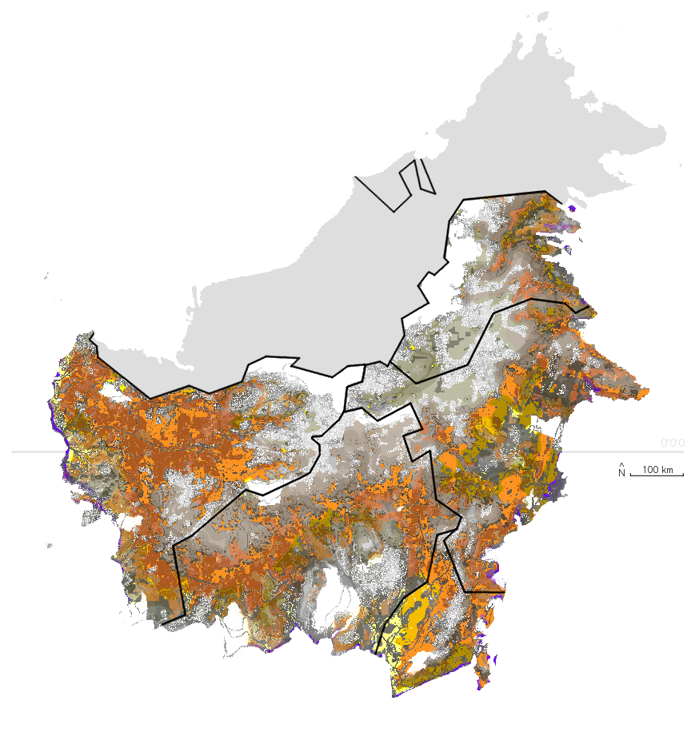
Synthesis
23 P5 UM+C
Douwe Douma
Affected ecoregions

Slide 24
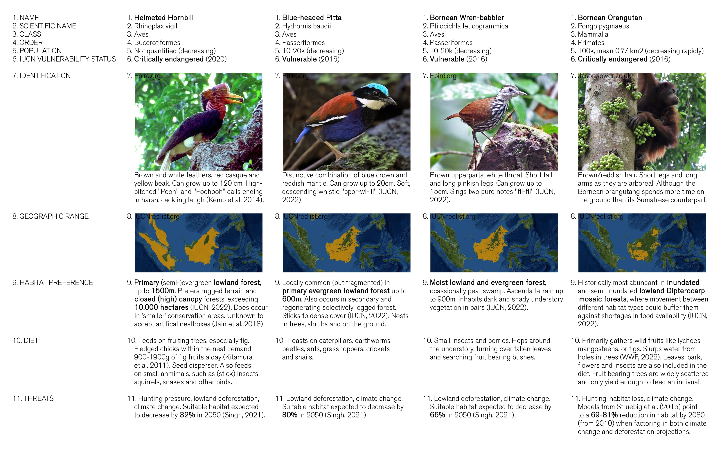
Target species
1km
24 P5 UM+C
Douwe Douma

Slide 25
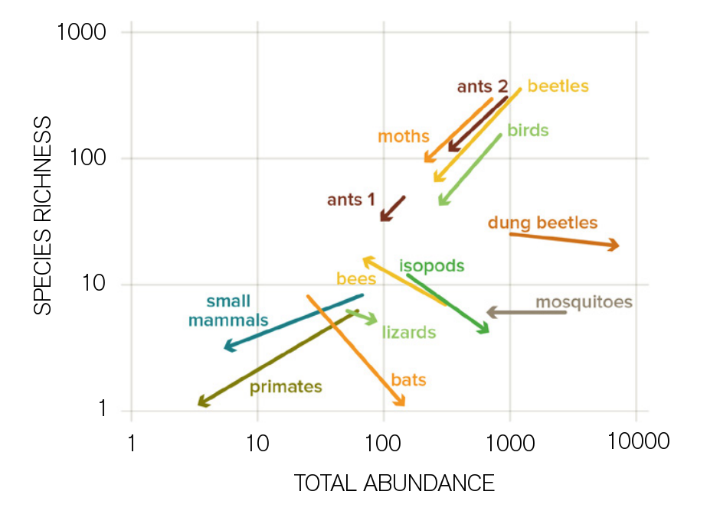
Literature review conclusions
25 P5 UM+C
Douwe Douma
Biodiversity
Heterogenity or ‘spatial complexity’
Species richness declines

Slide 26
26 P5 UM+C
Douwe Douma
Design

Slide 27
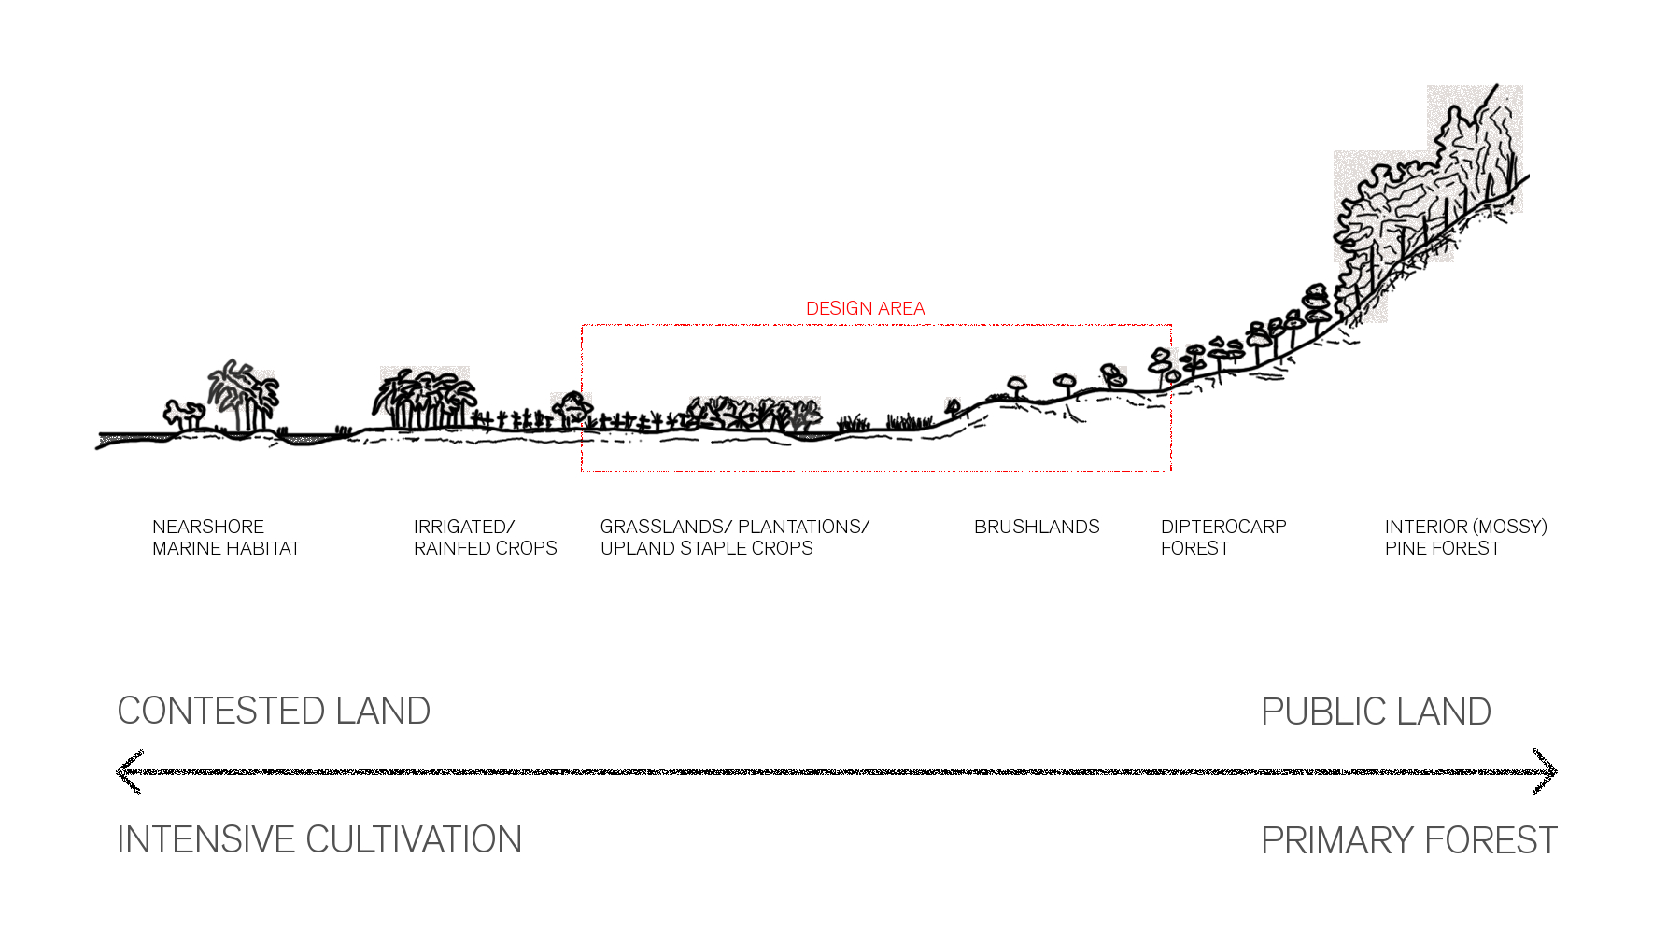
Site selection
27 P5 UM+C
Douwe Douma

Slide 28
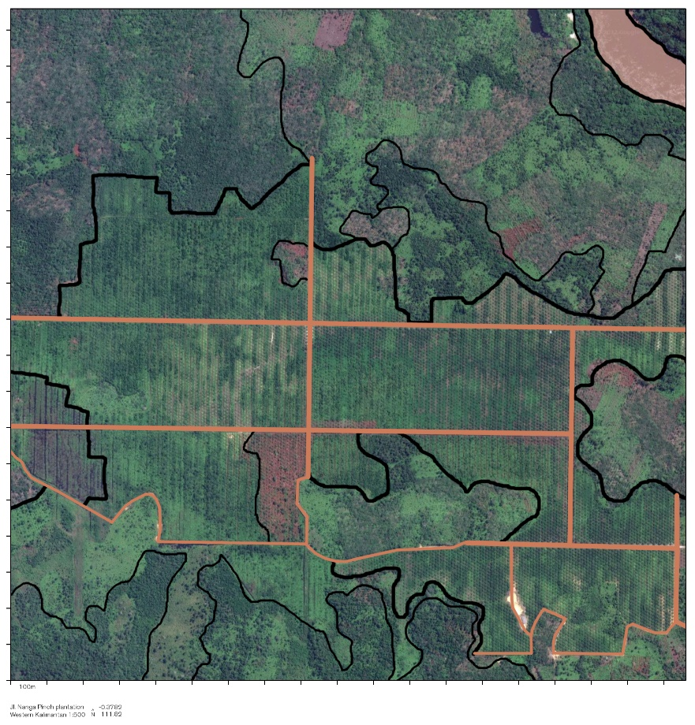
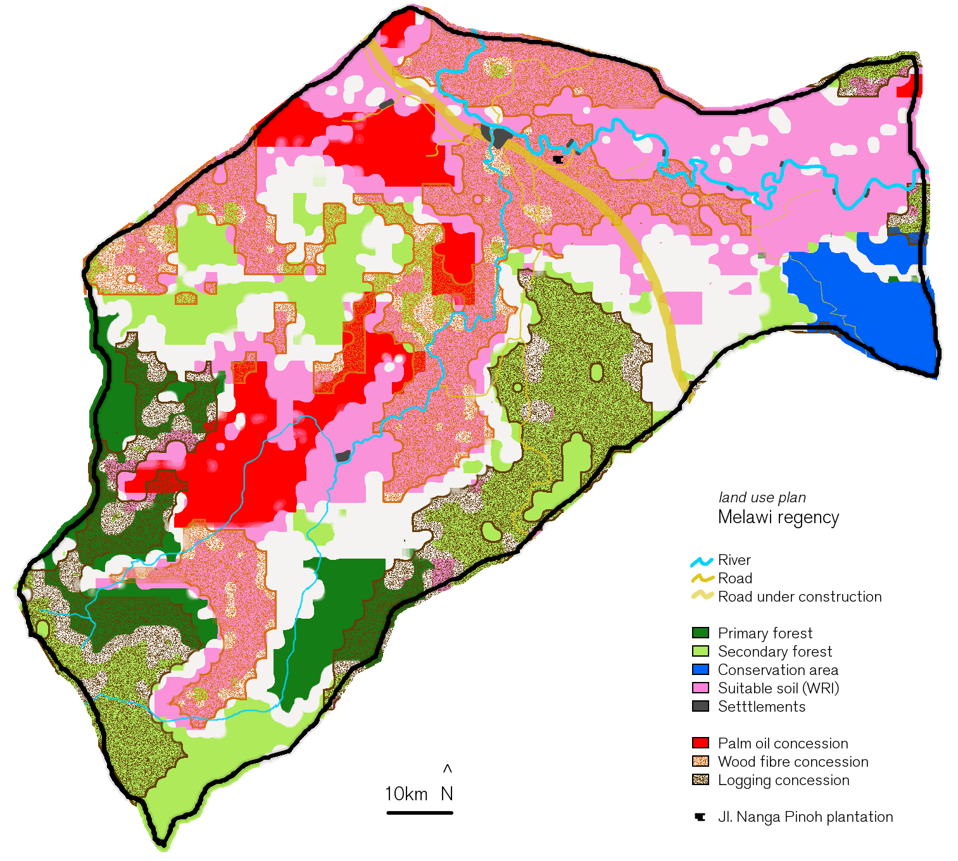
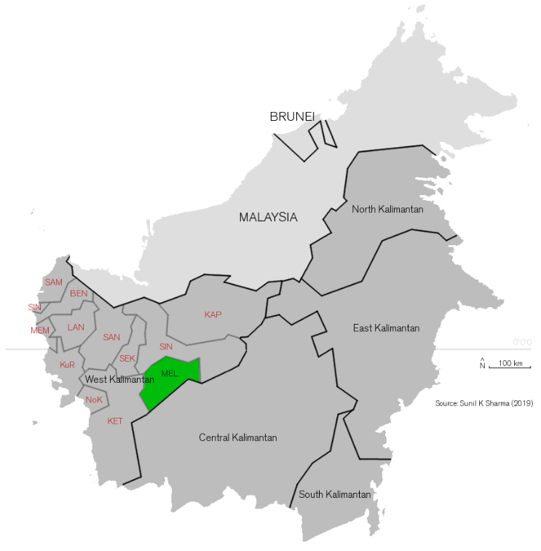
Site selection
28 P5 UM+C
Douwe Douma

Slide 29
Current grid
29 P5 UM+C
Douwe Douma

Slide 30
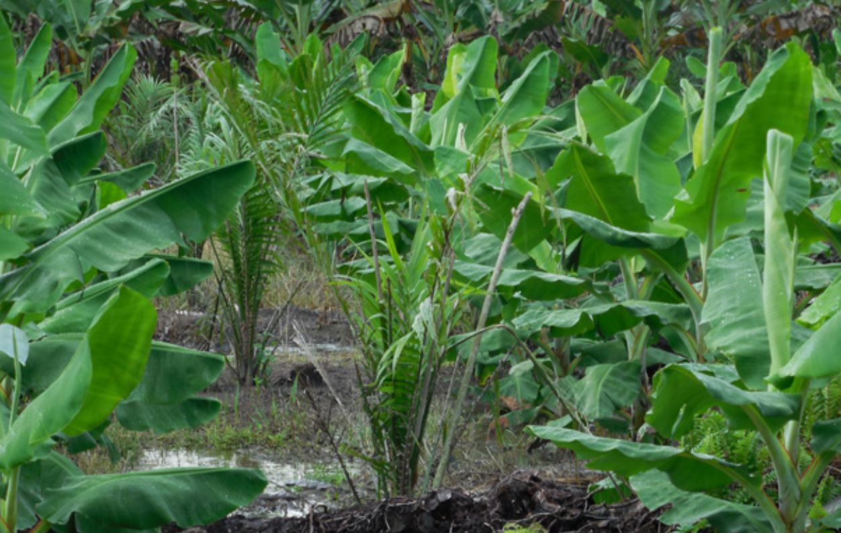
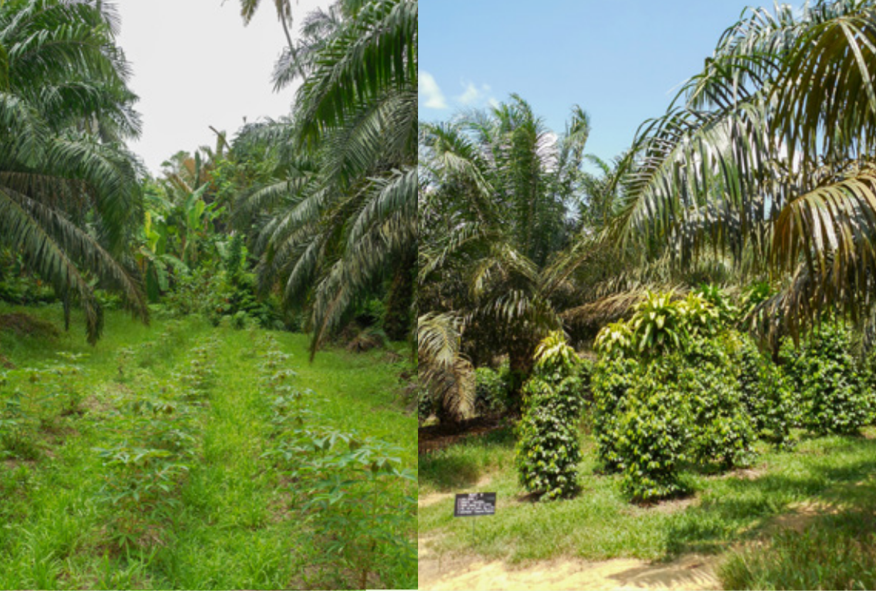
Intercropping
30 P5 UM+C
Douwe Douma

Slide 31
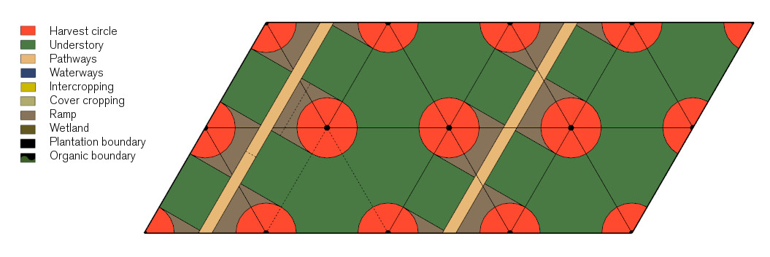
Proposed grid
31 P5 UM+C
Douwe Douma

Slide 32
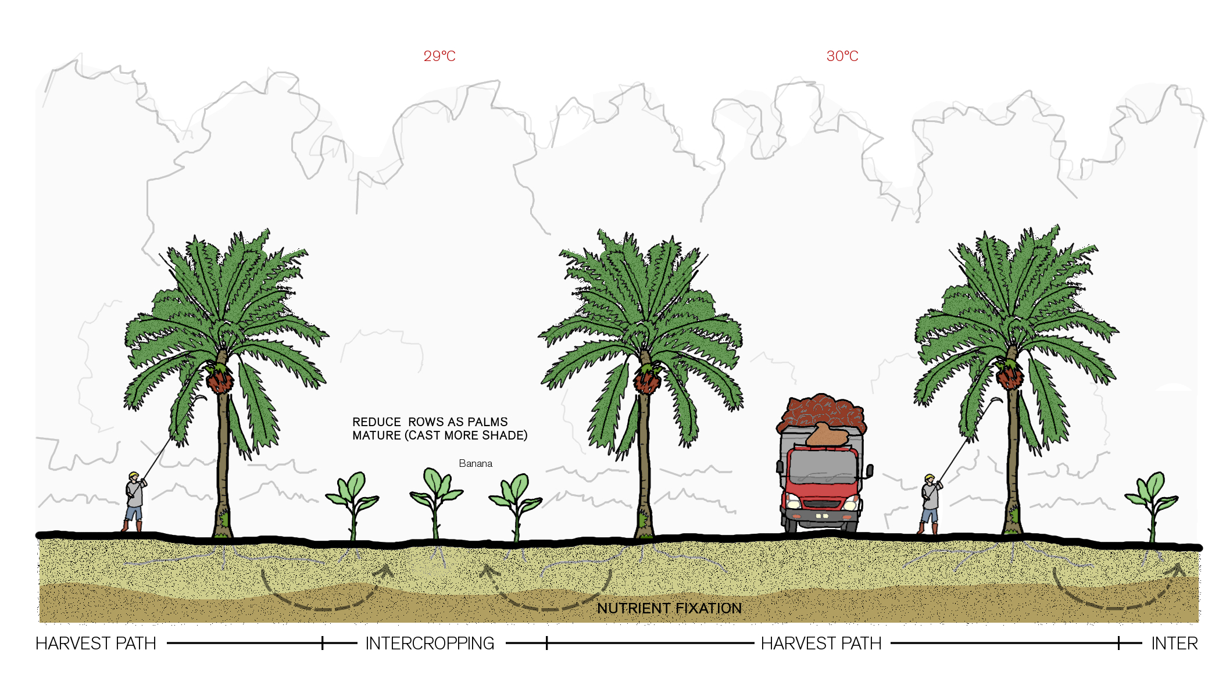
Typical section intercropping
32 P5 UM+C
Douwe Douma

Slide 33
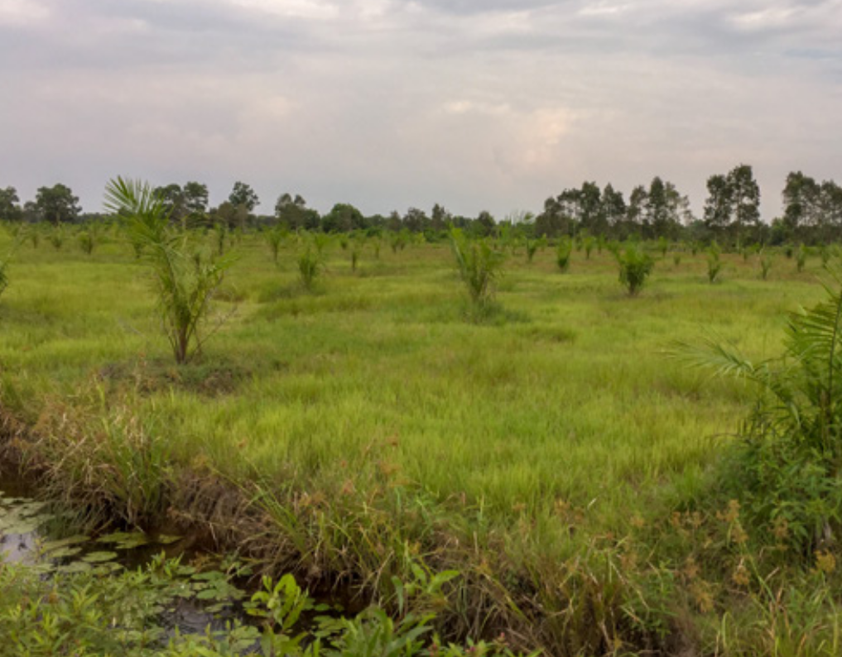
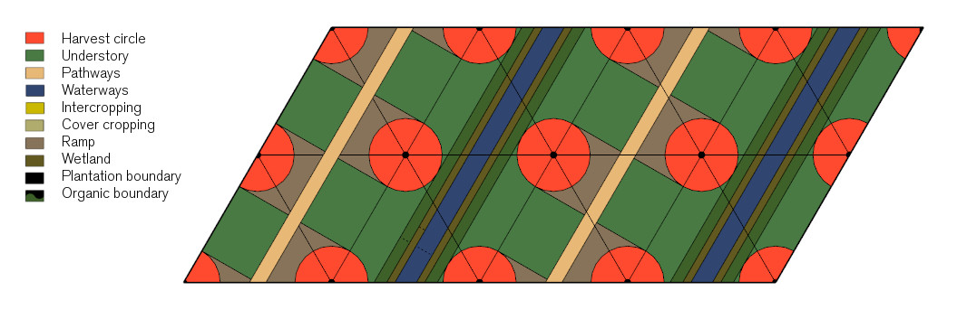
Drainage ditches
33 P5 UM+C
Douwe Douma

Slide 34
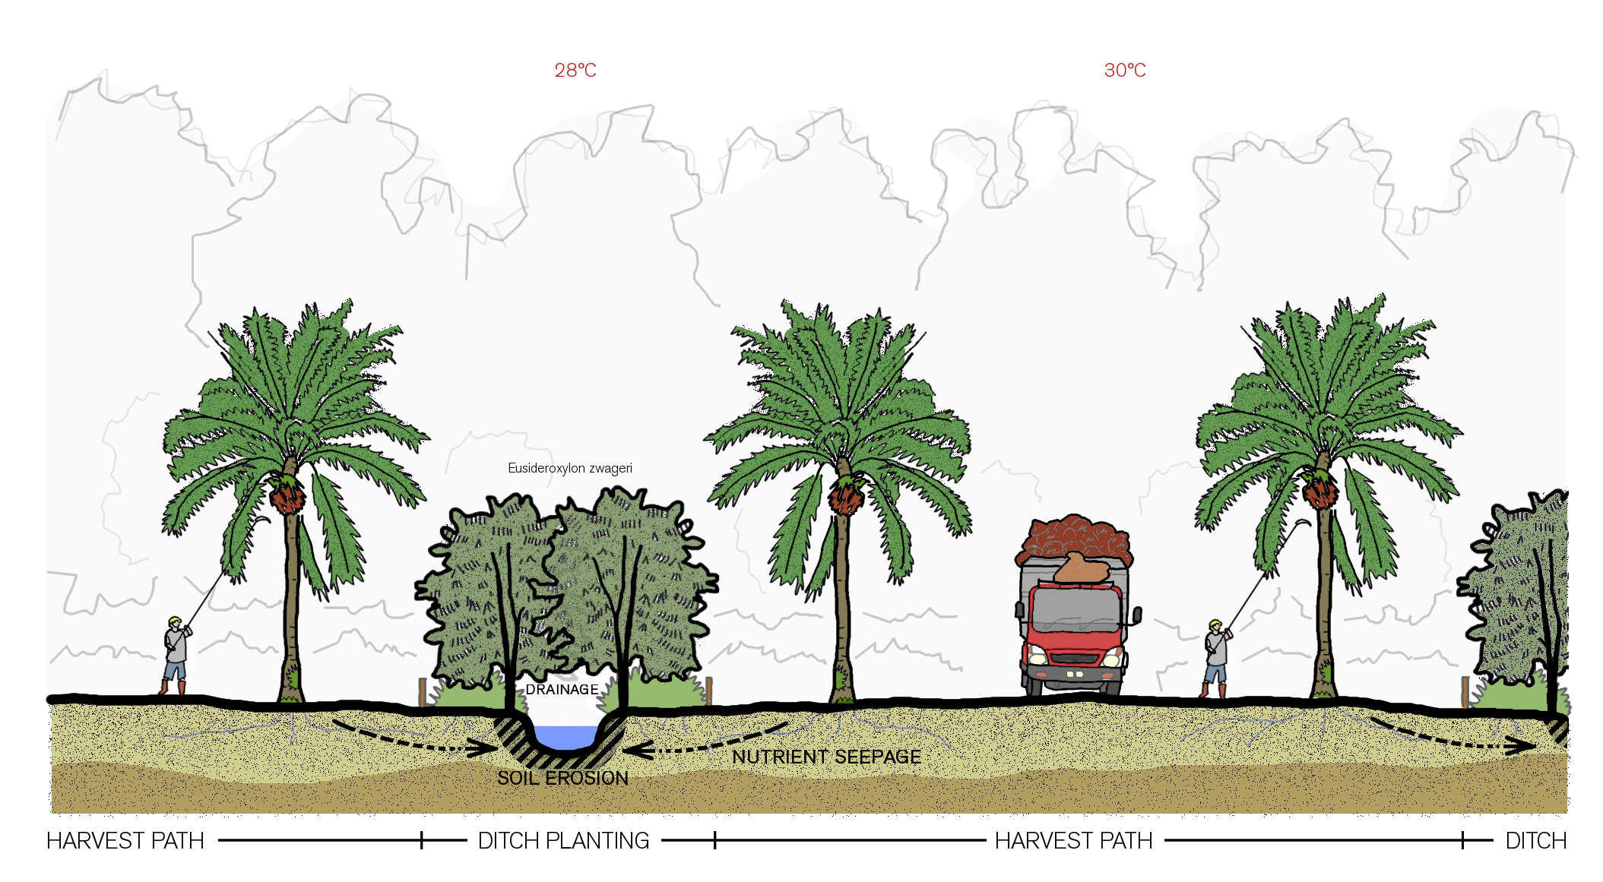
Typical section ditch planting
34 P5 UM+C
Douwe Douma

Slide 35
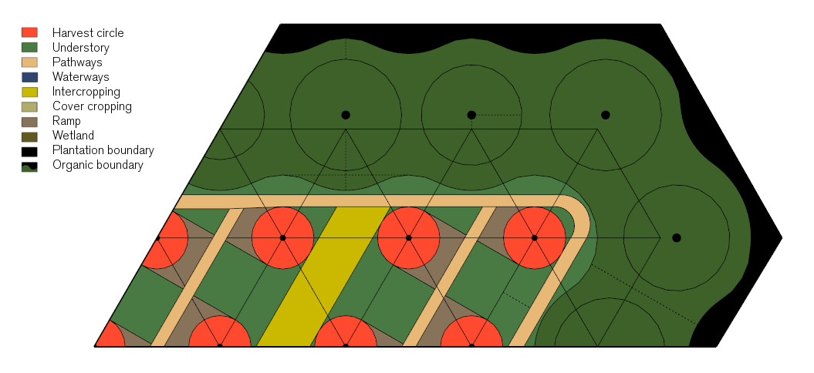
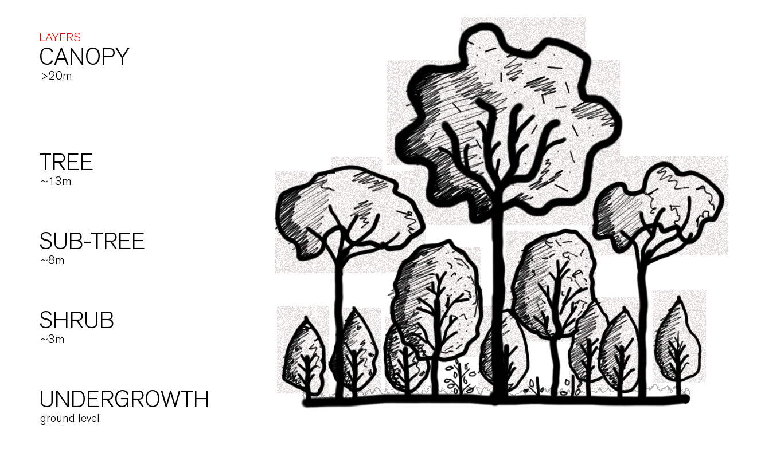
Boundary planting
35 P5 UM+C
Douwe Douma

Slide 36
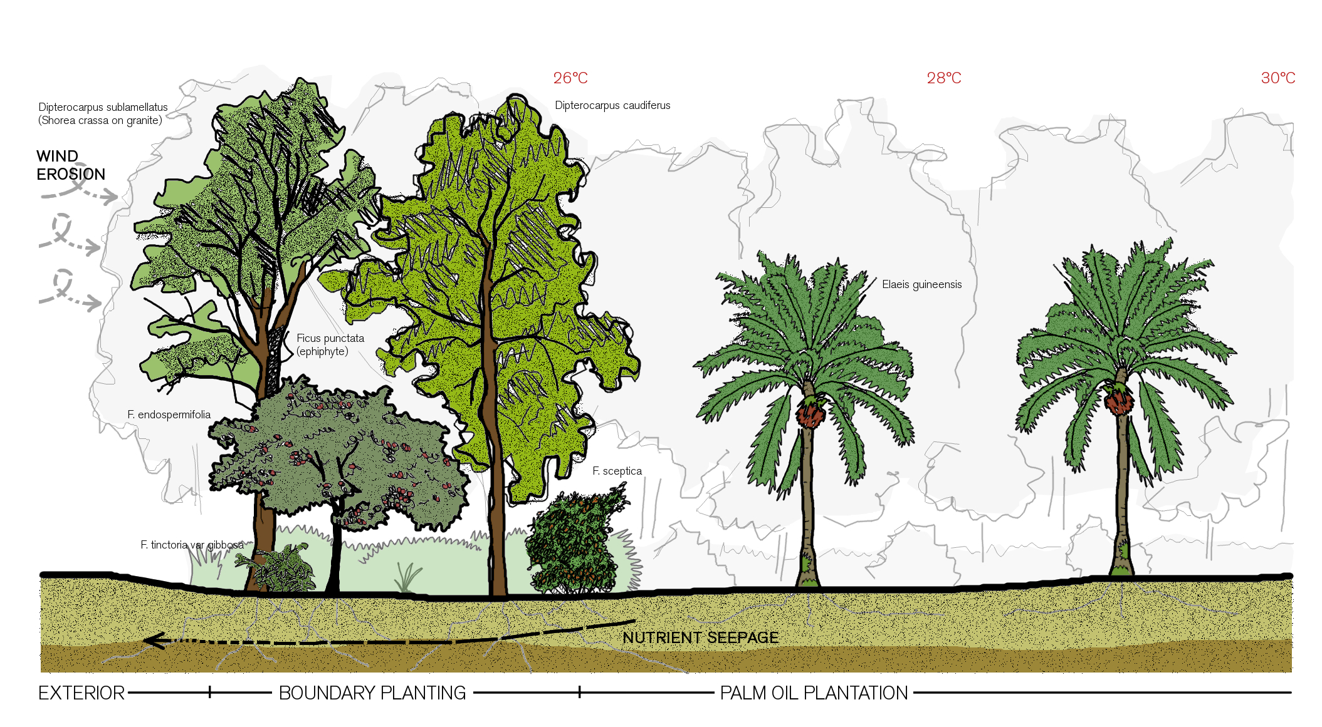
Typical section boundary planting
36 P5 UM+C
Douwe Douma

Slide 37
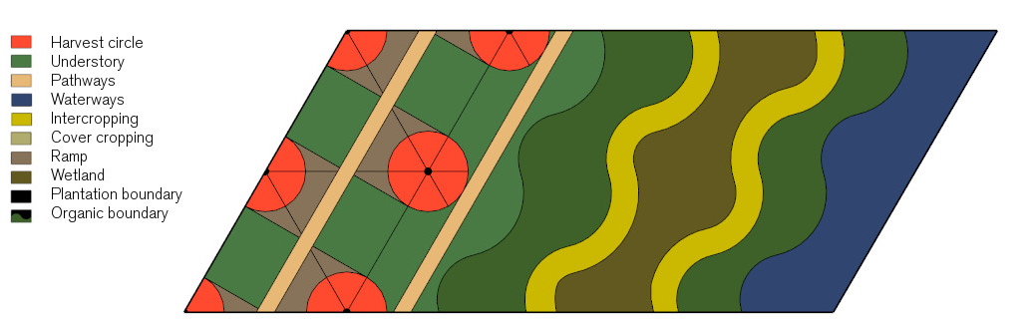
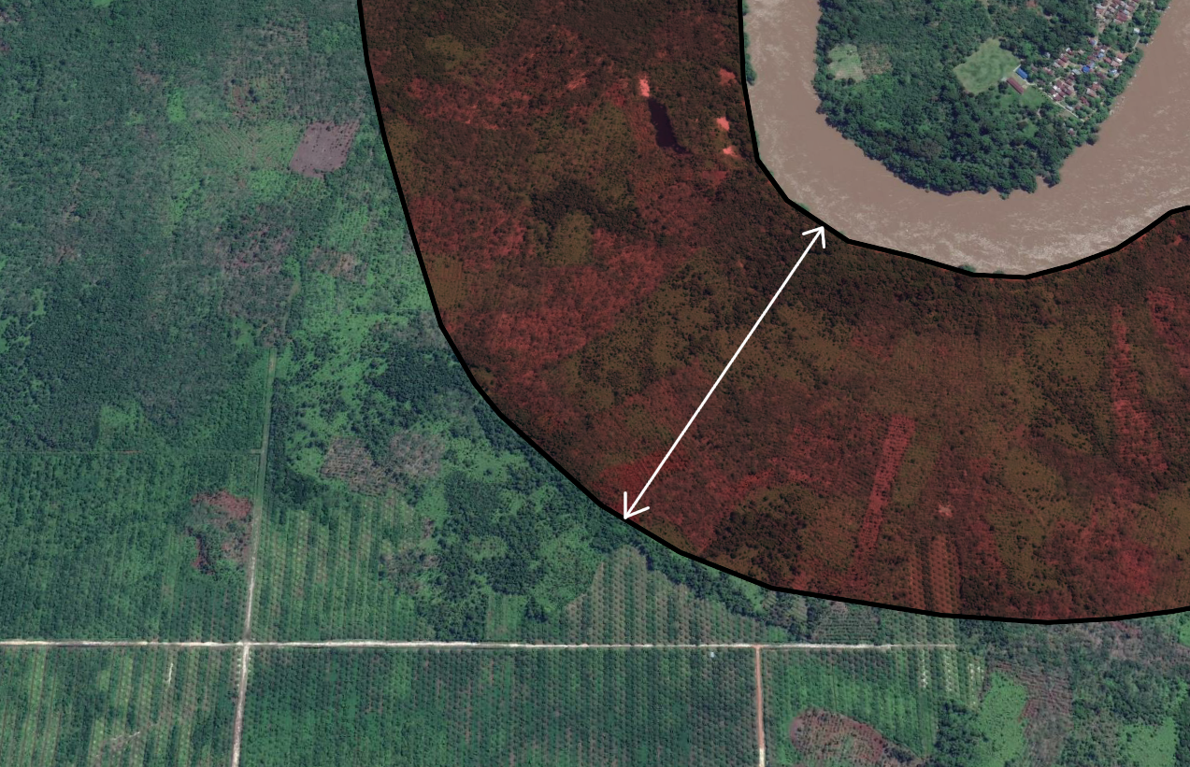
Restoring riparian buffers
37 P5 UM+C
Douwe Douma

Slide 38
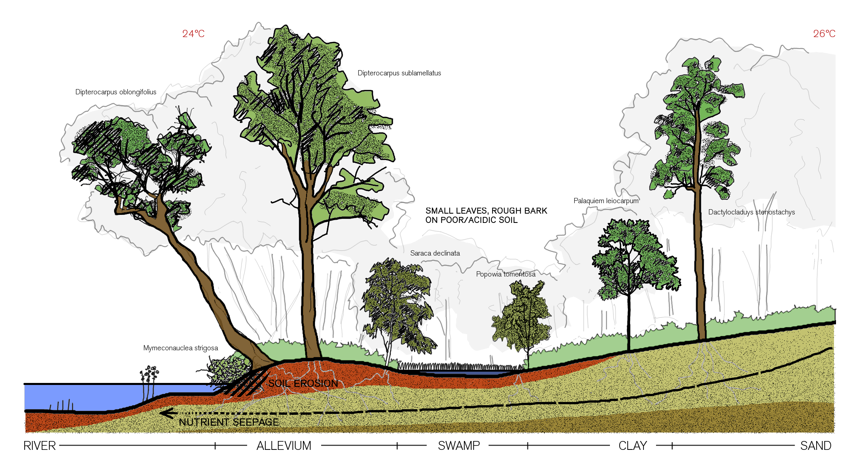
Typical section riparian buffer
38 P5 UM+C
Douwe Douma

Slide 39
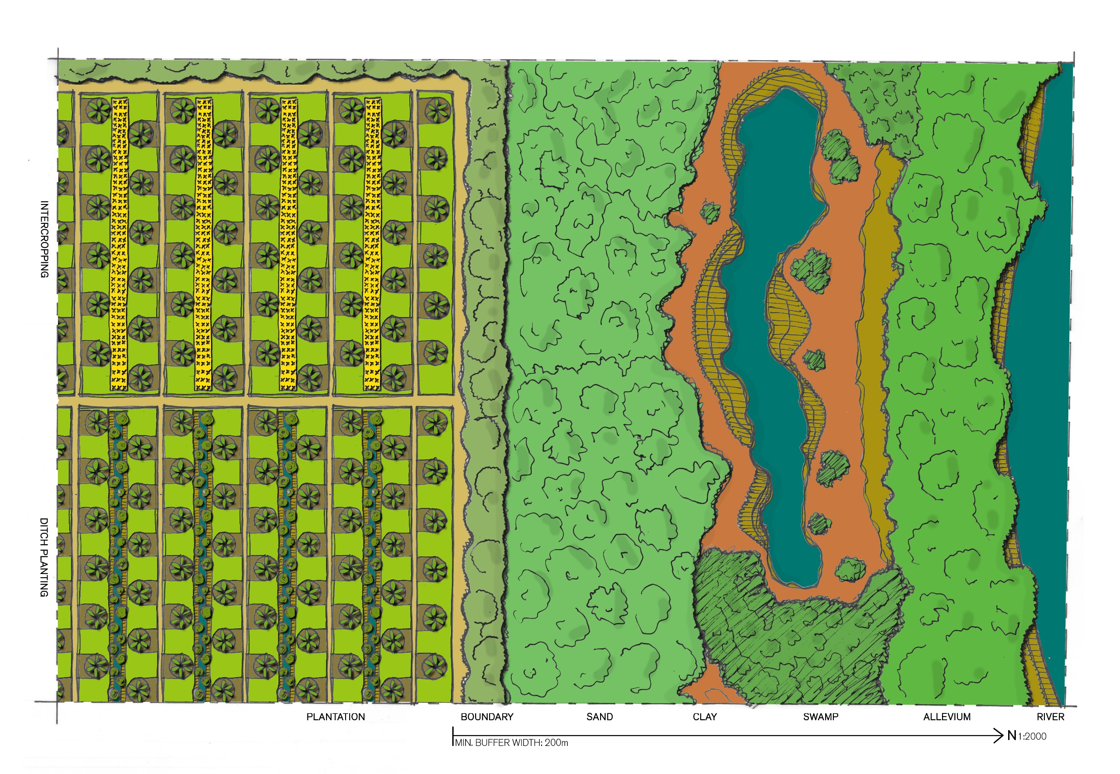
Pilot plantation overview
27 P4 UM+C
Douwe Douma

Slide 40
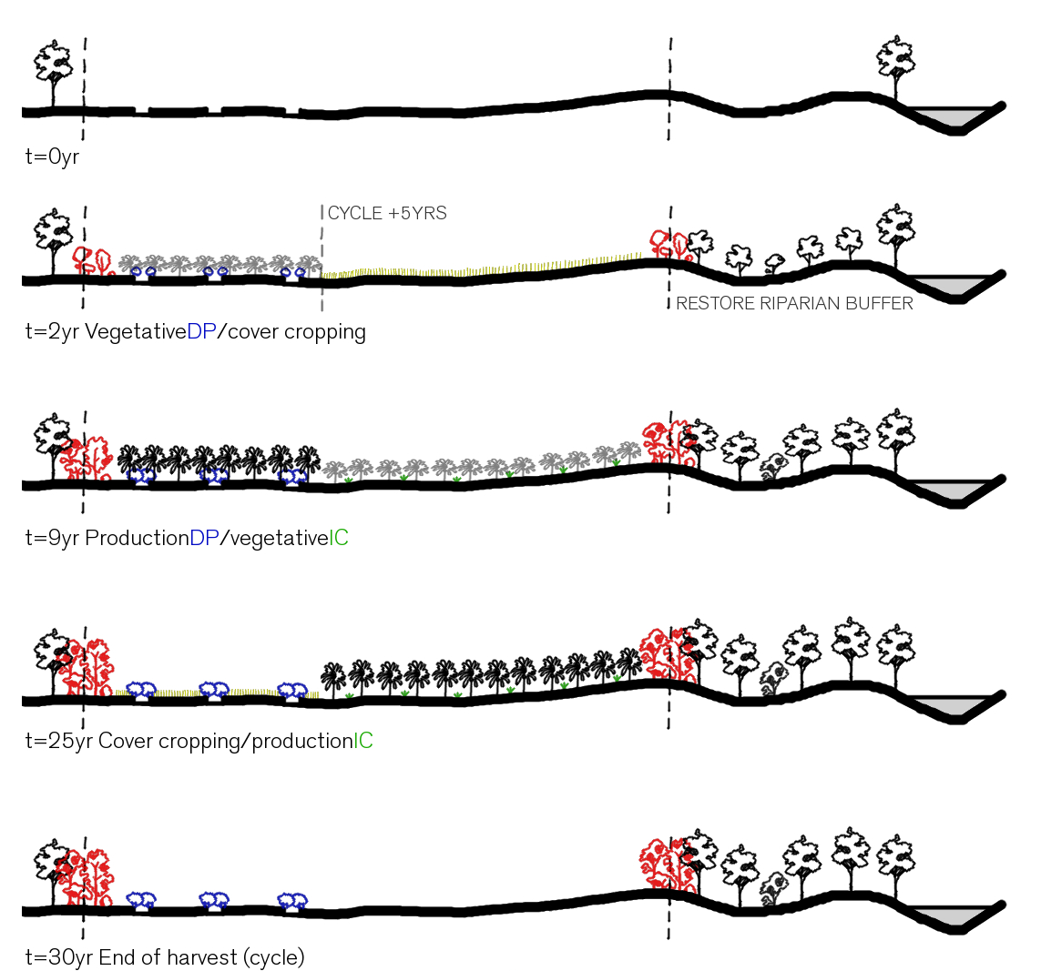
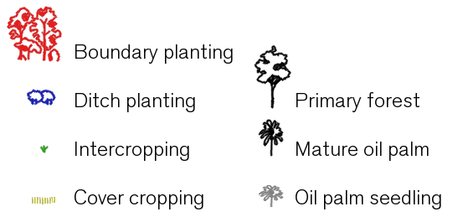
Phasing
40 P5 UM+C
Douwe Douma
ESA Copernicus II above Eastern Kalimantan palm oil expansion (2019)
© Unilever

Slide 41
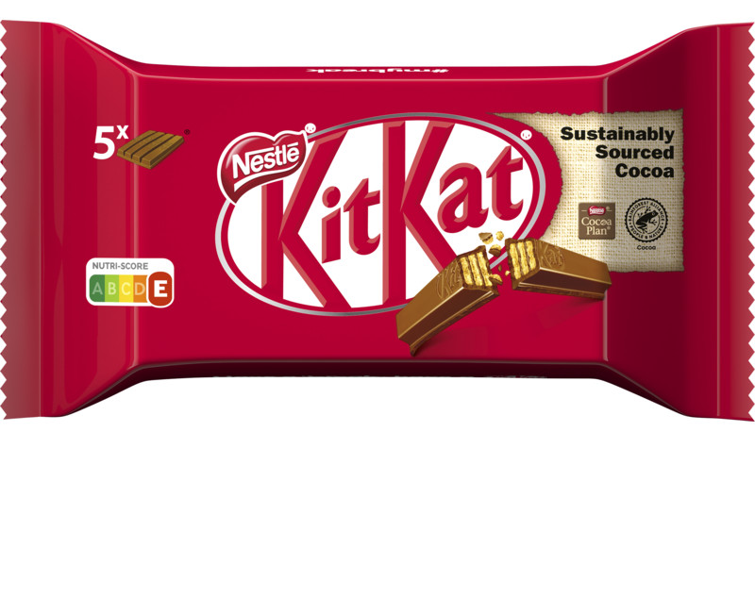
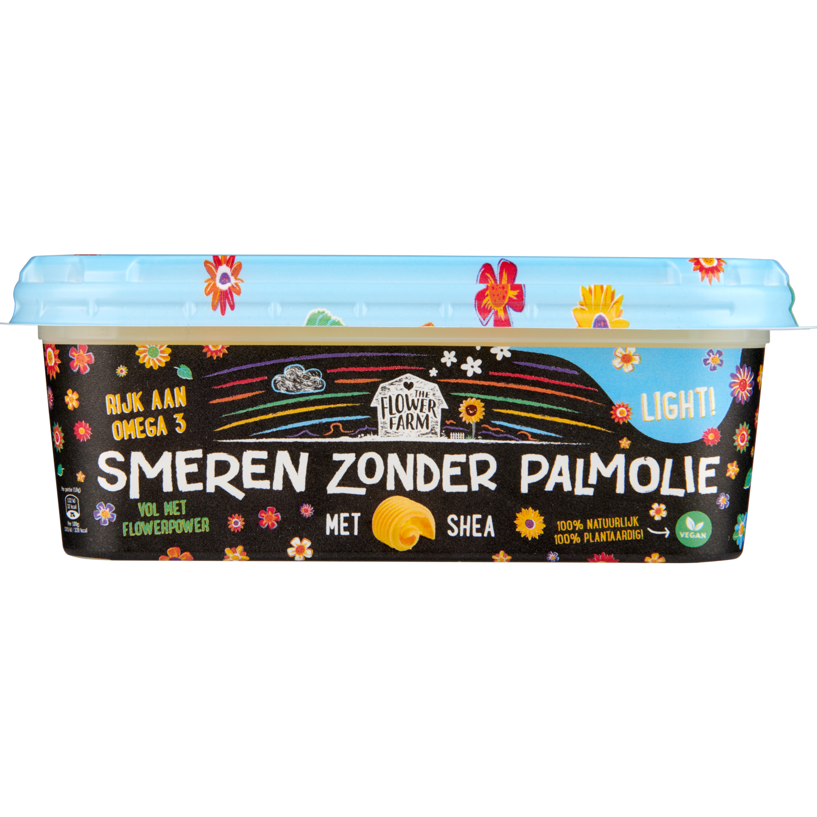
Certification
41 P5 UM+C
Douwe Douma

Slide 42
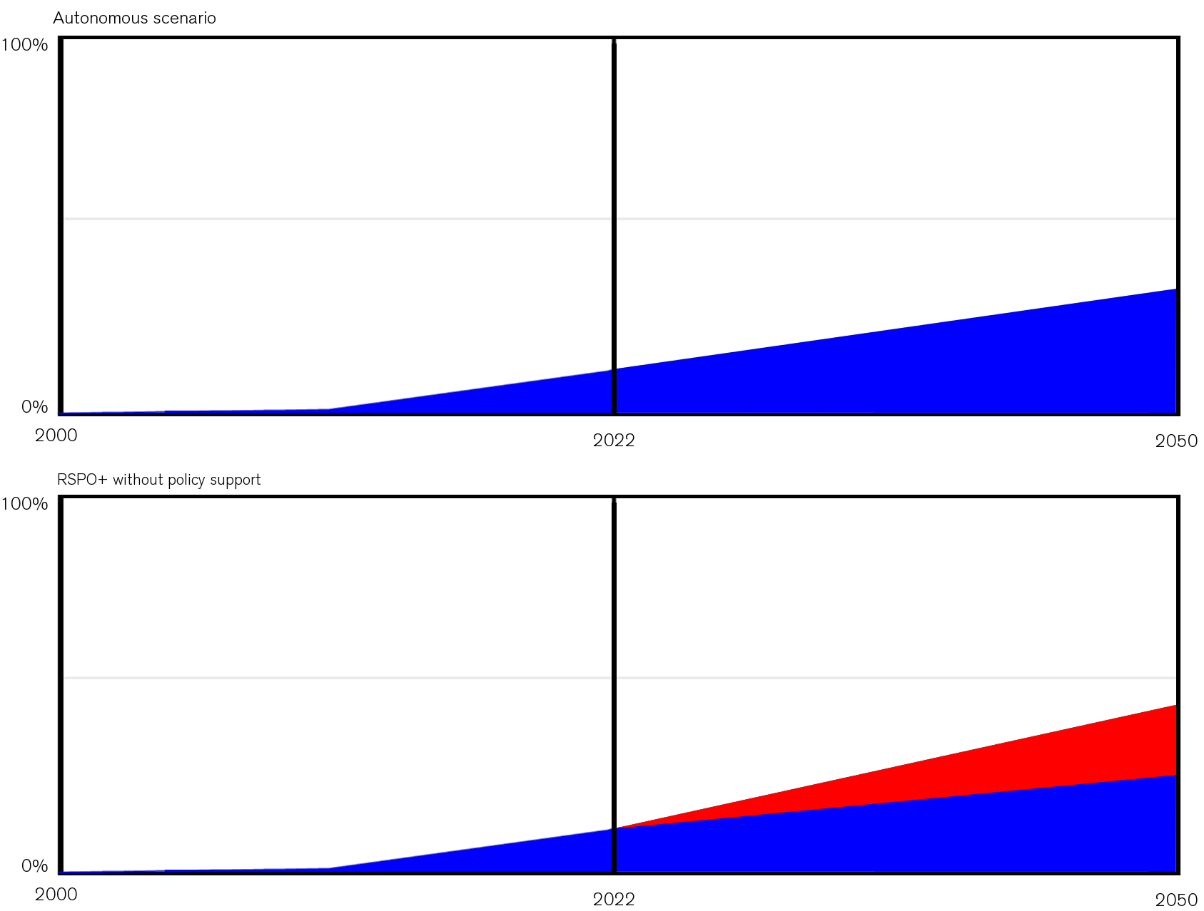
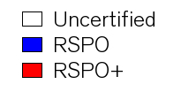
Implementation timeline
42 P5 UM+C
Douwe Douma

Slide 43
Implementation timeline
43 P5 UM+C
Douwe Douma

